Slide 1
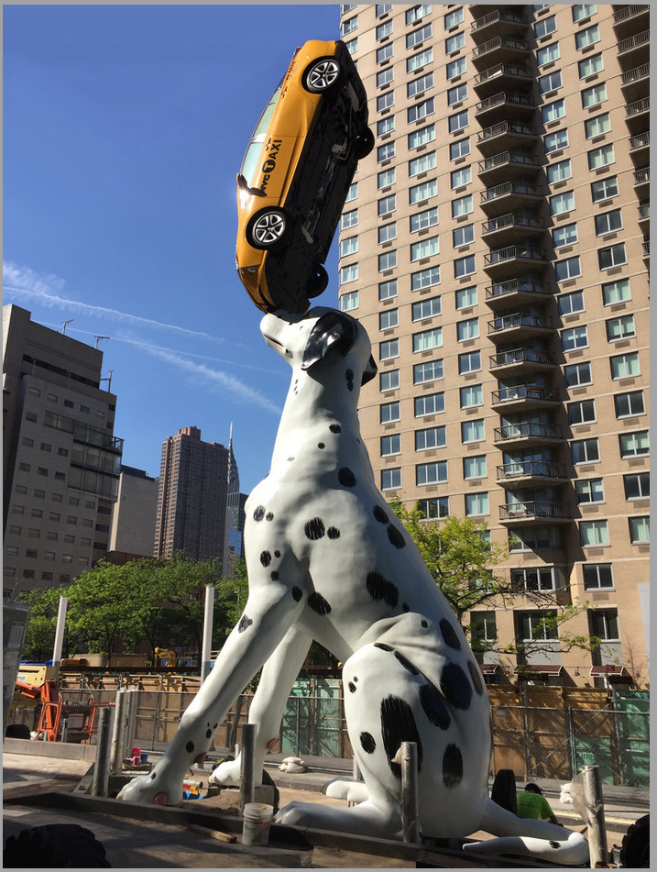
MCAA Medical Research Building
New York, NY

Slide 2
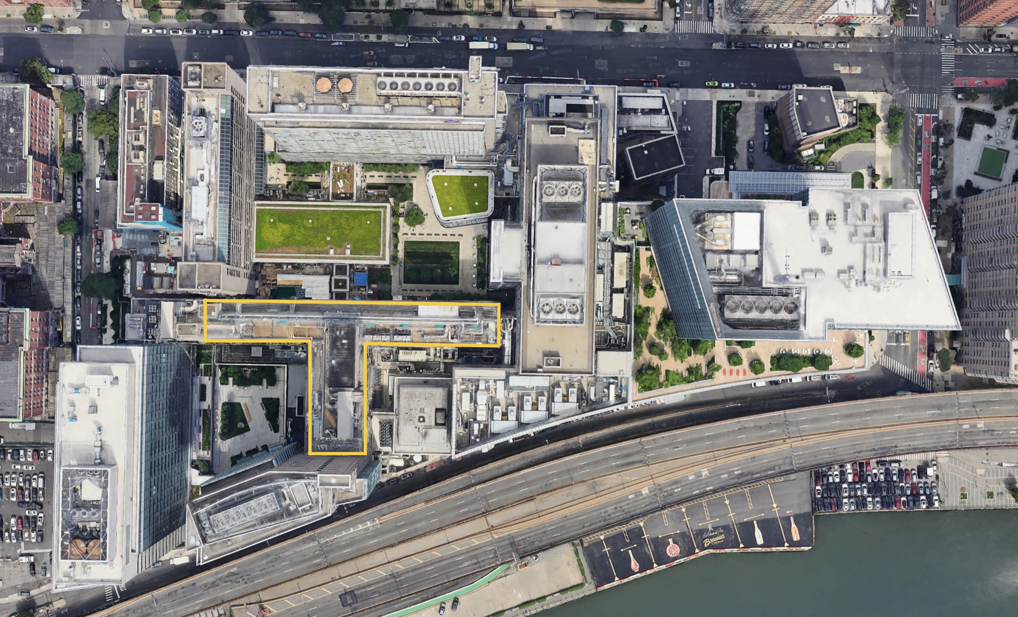
Location
East Side of Manhattan
Campus Utilities used for secondary systems within the building
Campus wide standards must be followed

Slide 3
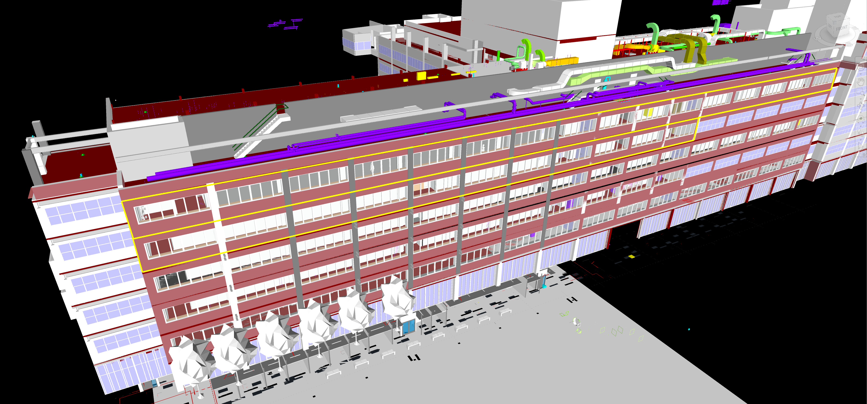
Scope of Work
5th Floor North – 6th Floor North – 6th Floor South– 7th Floor Machine Rooms
Piping – Ductwork Insulation

Slide 4
Logistics
Only One Loading Dock
Contractor use 6am to 7am (all campus wide projects)
Must be scheduled 48 hours in advance
All Other deliveries must be taken at the curb and wheeled into the building
Vertical Transport
One Freight Elevator for the Project
Freight Elevator Dimensions – 10’-6” long by 6’-2” wide by 10’-0” tall
Weight Limit – 5000 lbs
Any load over 2500 lbs requires an elevator operator
Gas Cylinder Storage is NOT allowed on campus
All air and gas cylinders must be removed from campus at end of shift each day
No exceptions
Construction Manager Requirement – Stretch and Flex
15 minutes at the start of each shift for all workers onsite

Slide 5
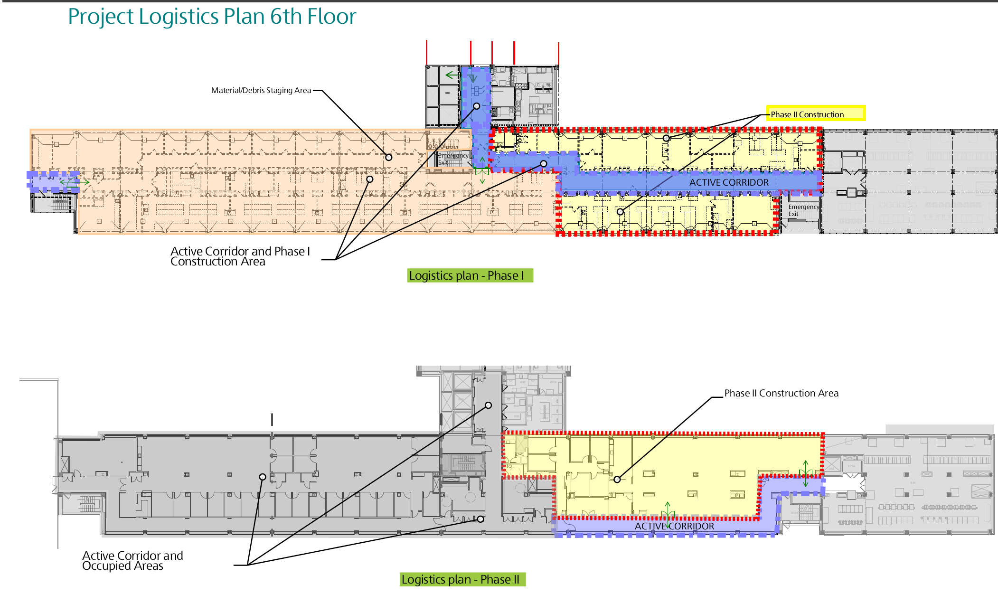
Logistics

Slide 6
Milestone Schedule
Bid Award – March 6th 2025
5th Floor Start – May 19th 2025
5th Floor Turnover to Owner – August 15th 2025
6th Floor Phase 1 Start – June 16th 2025
6th Floor Phase 1 Turnover to Owner – September 19th 2025
6th Floor Phase 2 Start – November 3rd 2025
6th Floor Phase 2 Turnover to Owner – January 19th 2026
7th Floor Start – May 19th 2025
7th Floor Phase 1 Turnover to Owner – August 1st 2025
7th Floor Phase 2 Turnover to Owner – December 15th 2025

Slide 7
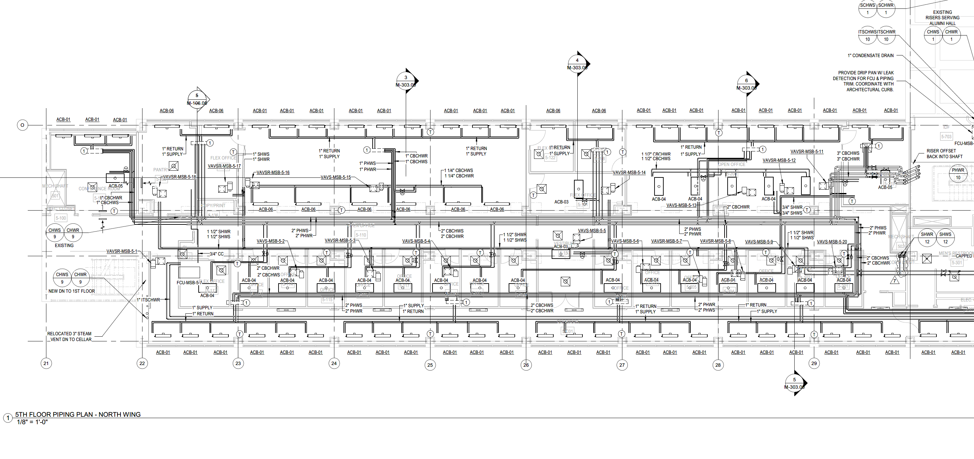
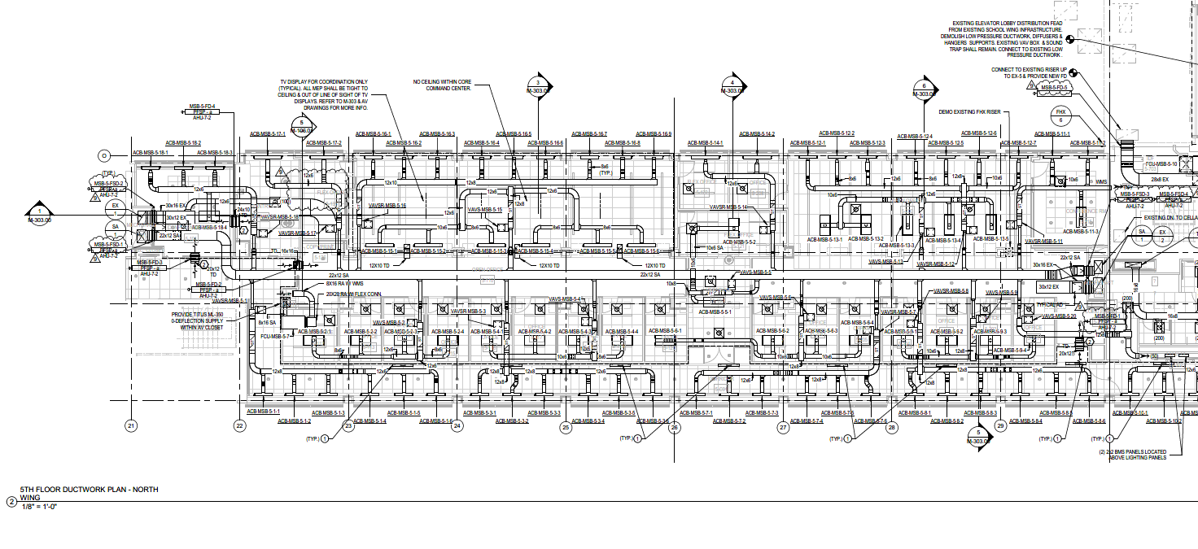
5th Floor – 6th Floor – Fitout of Floor
Piping
Ductwork

Slide 8
Active Chilled Beams
Conditioned air from 7th Floor AHU
Heat Water from Perimeter Hot Water System
Chilled Water from Chilled Beam Chilled Water System
Heating or Cooling selected by BMS via 6-way valve

Slide 9
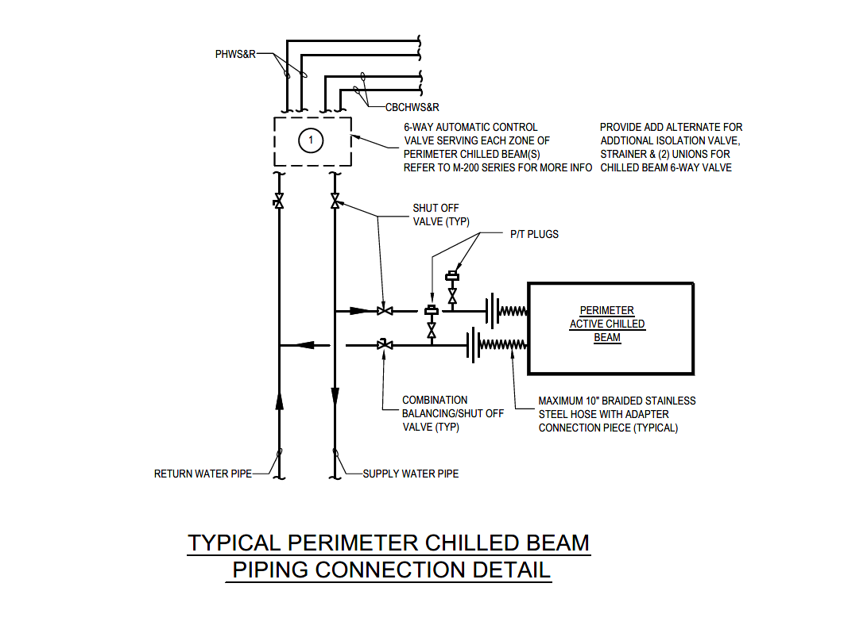
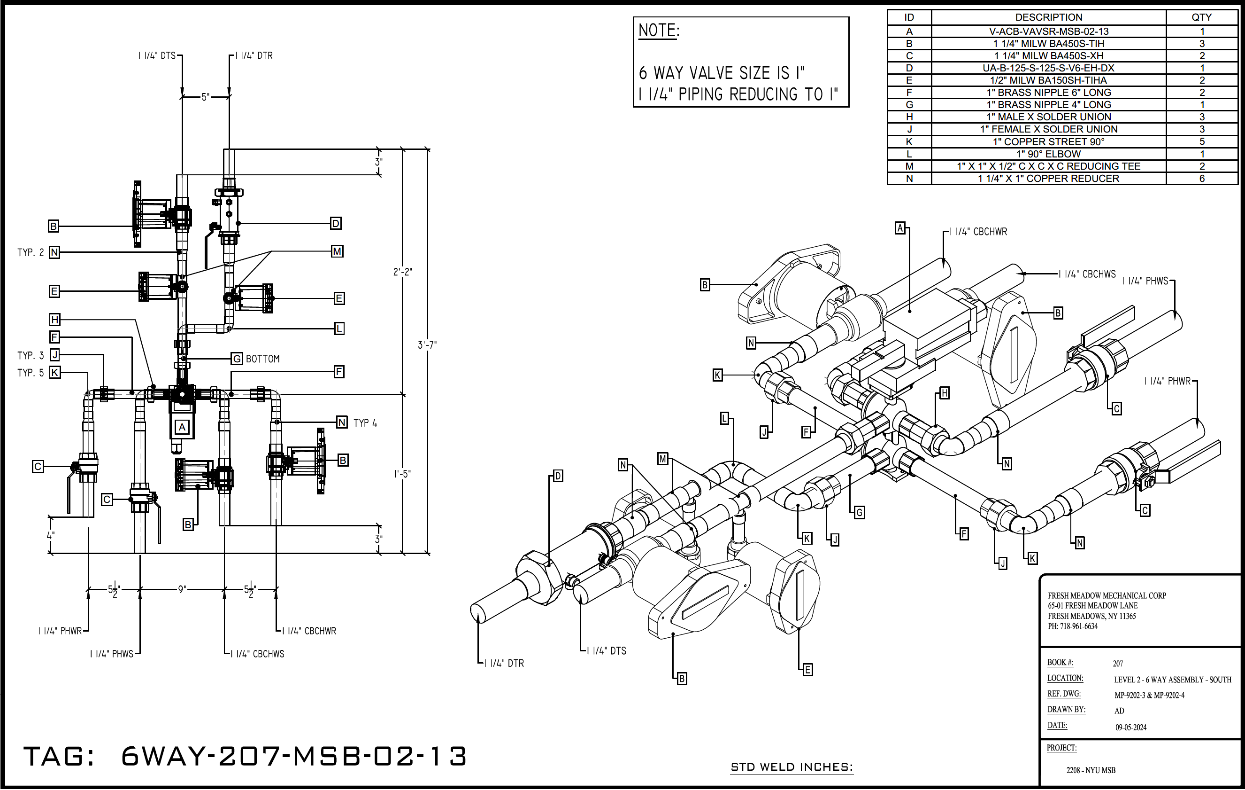
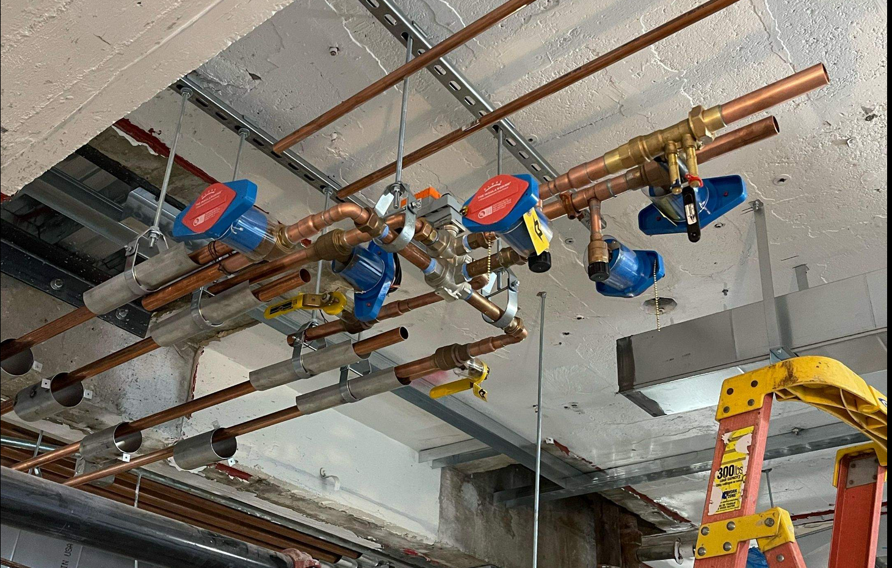

Slide 10
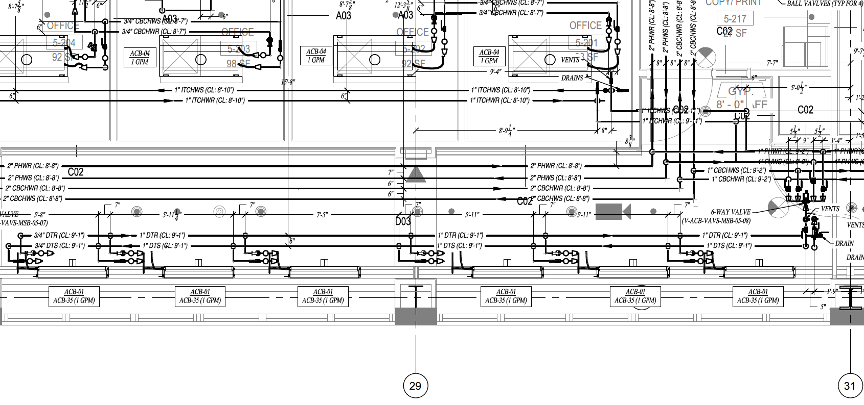
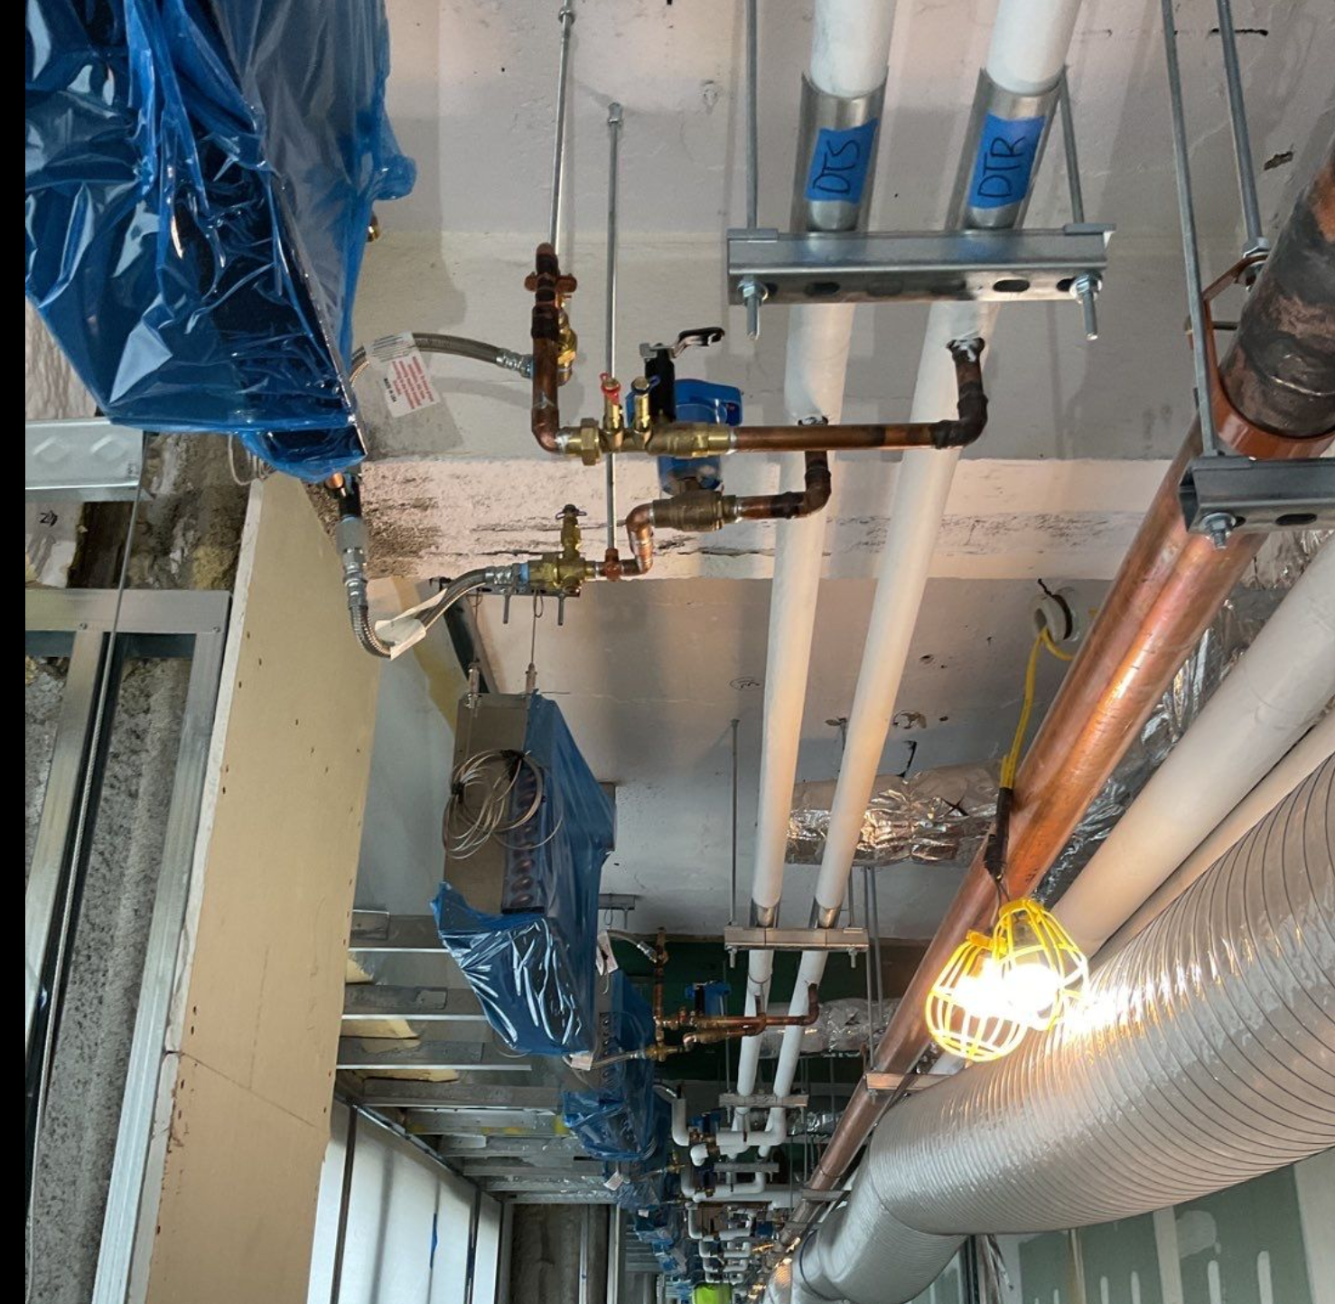
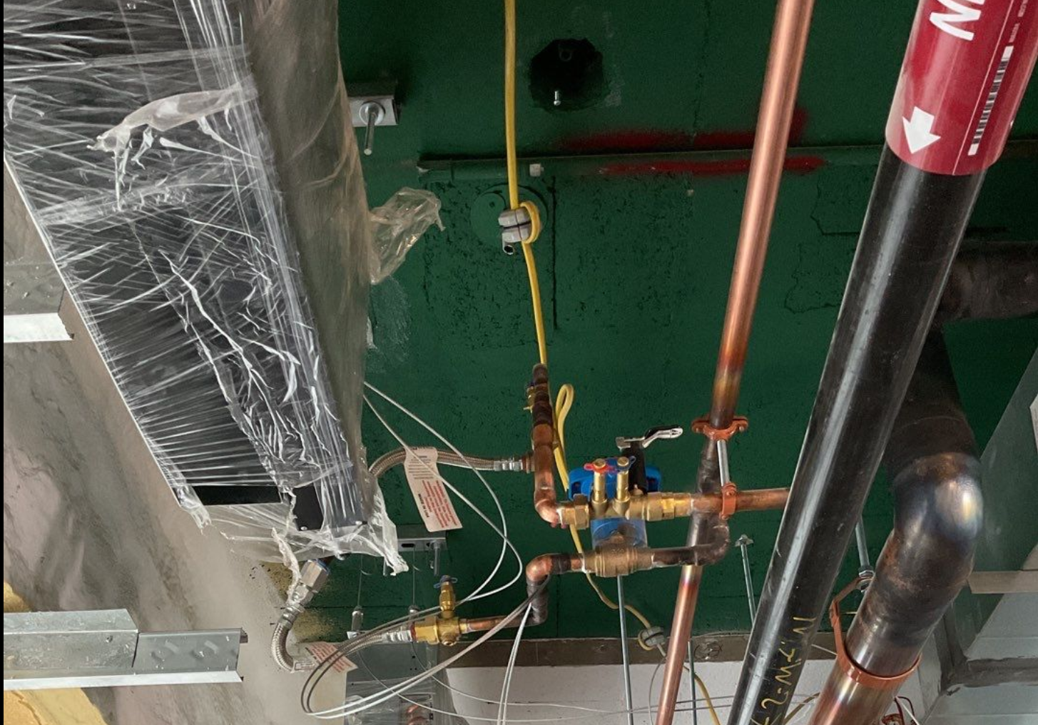

Slide 11
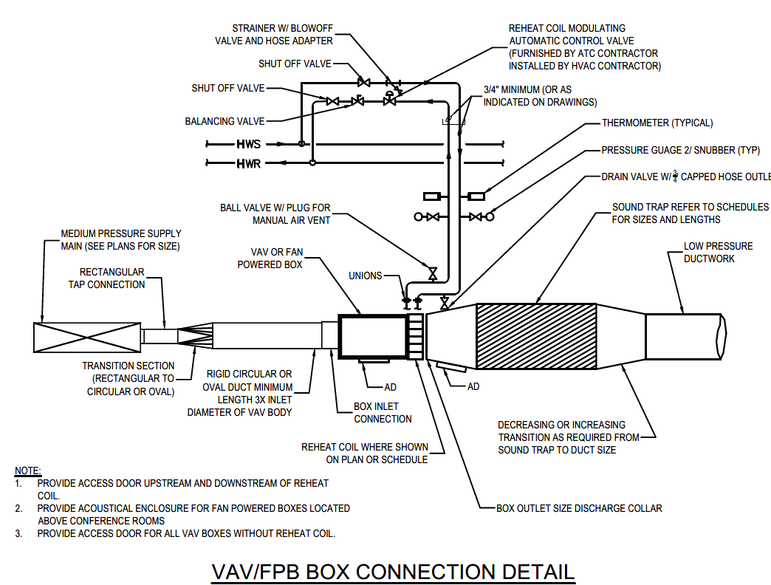
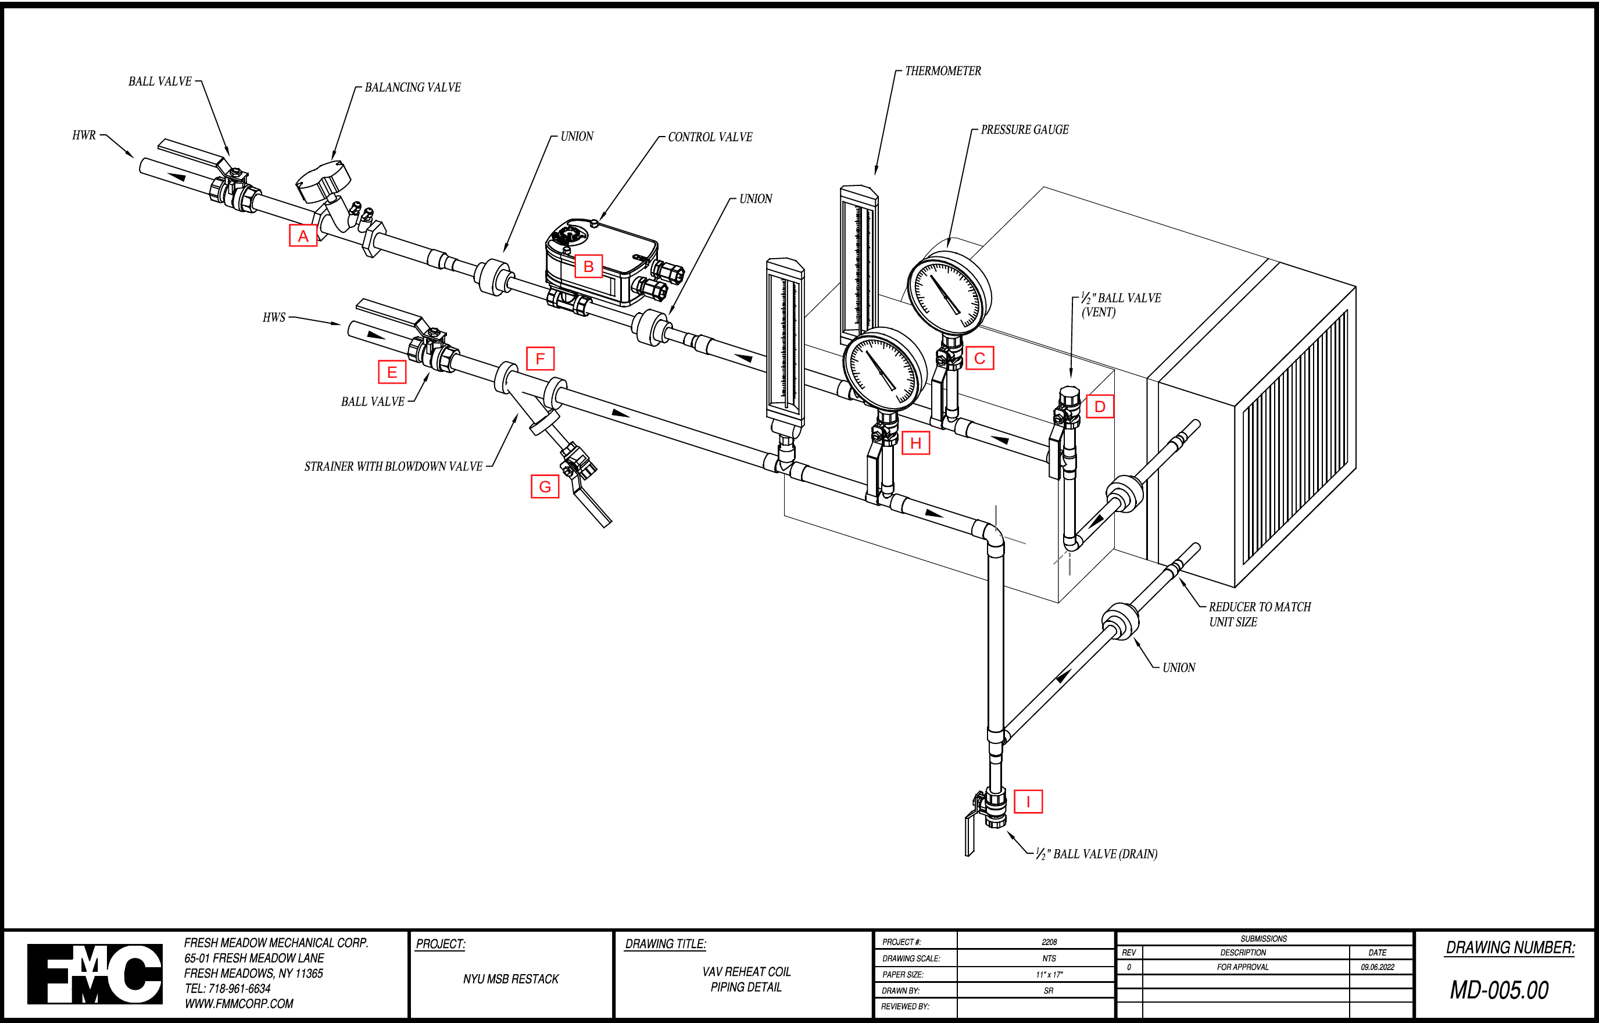
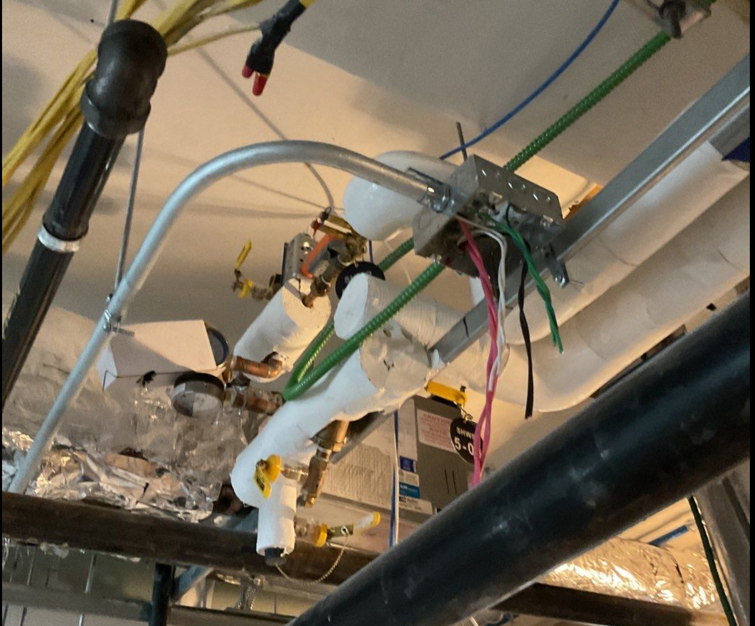

Slide 12
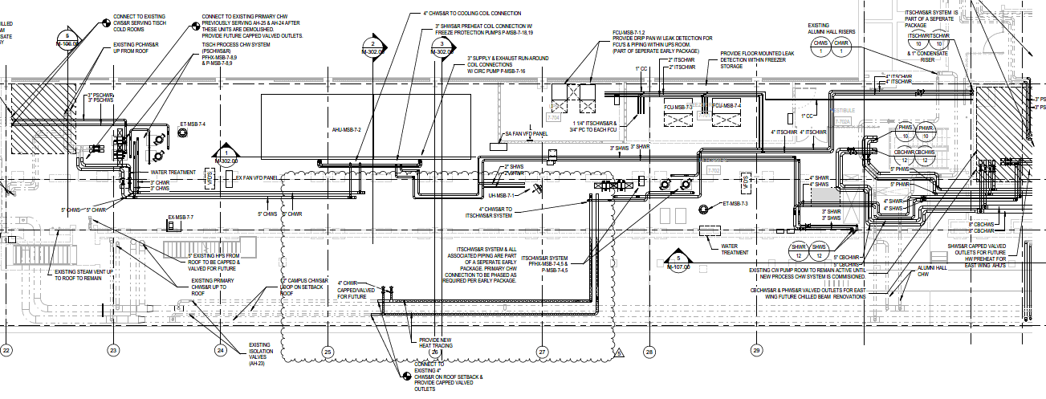
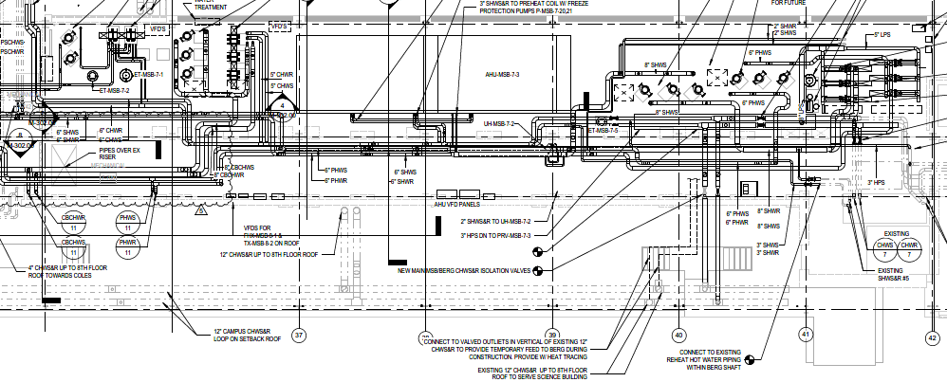
7th Floor – Design
North Side
South Side

Slide 13
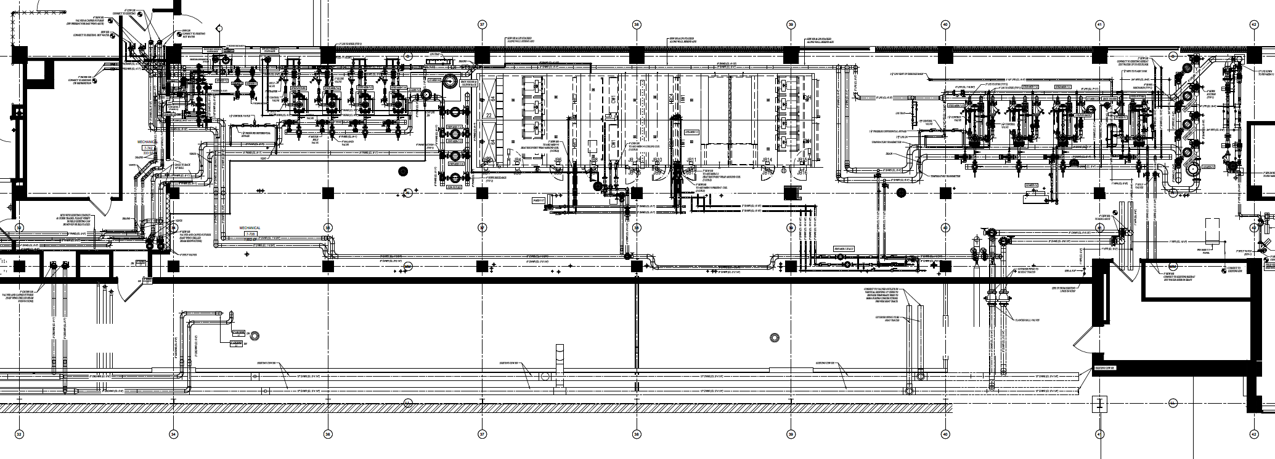
7th Floor – Coordinated
North Side
South Side

Slide 14
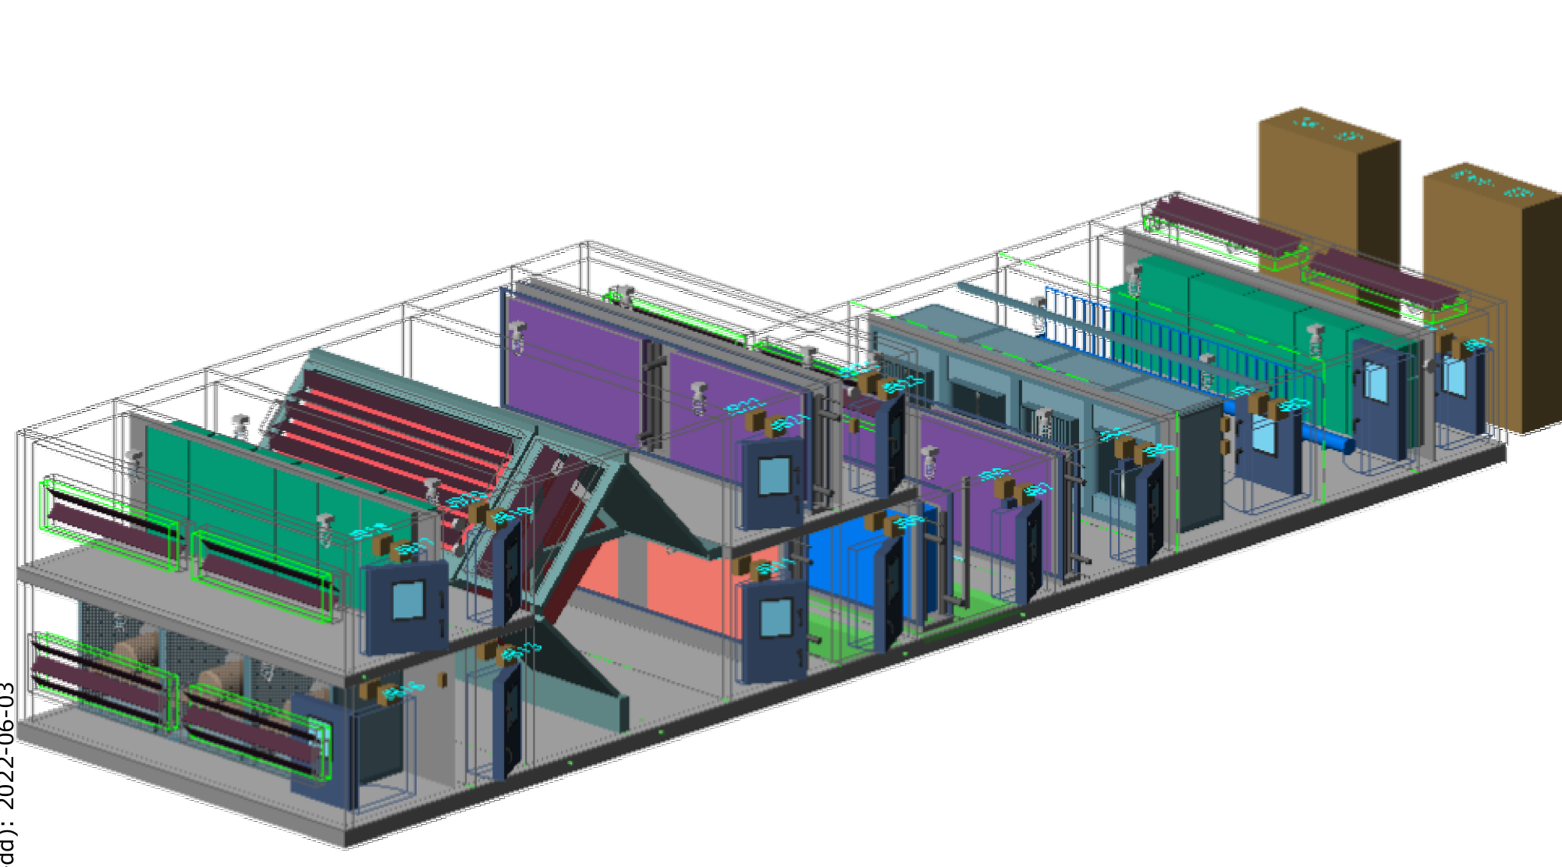
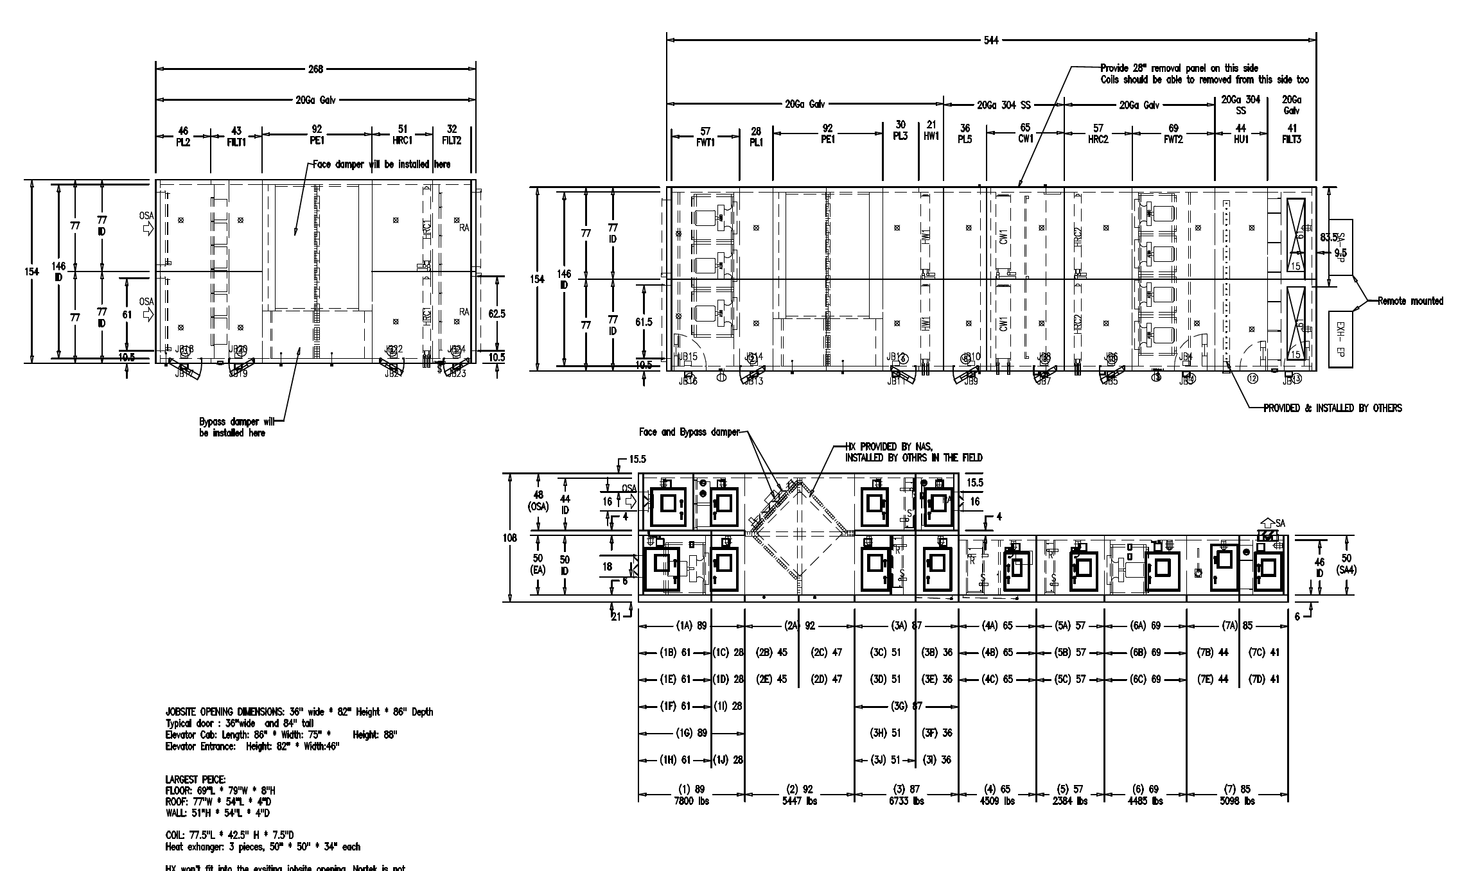
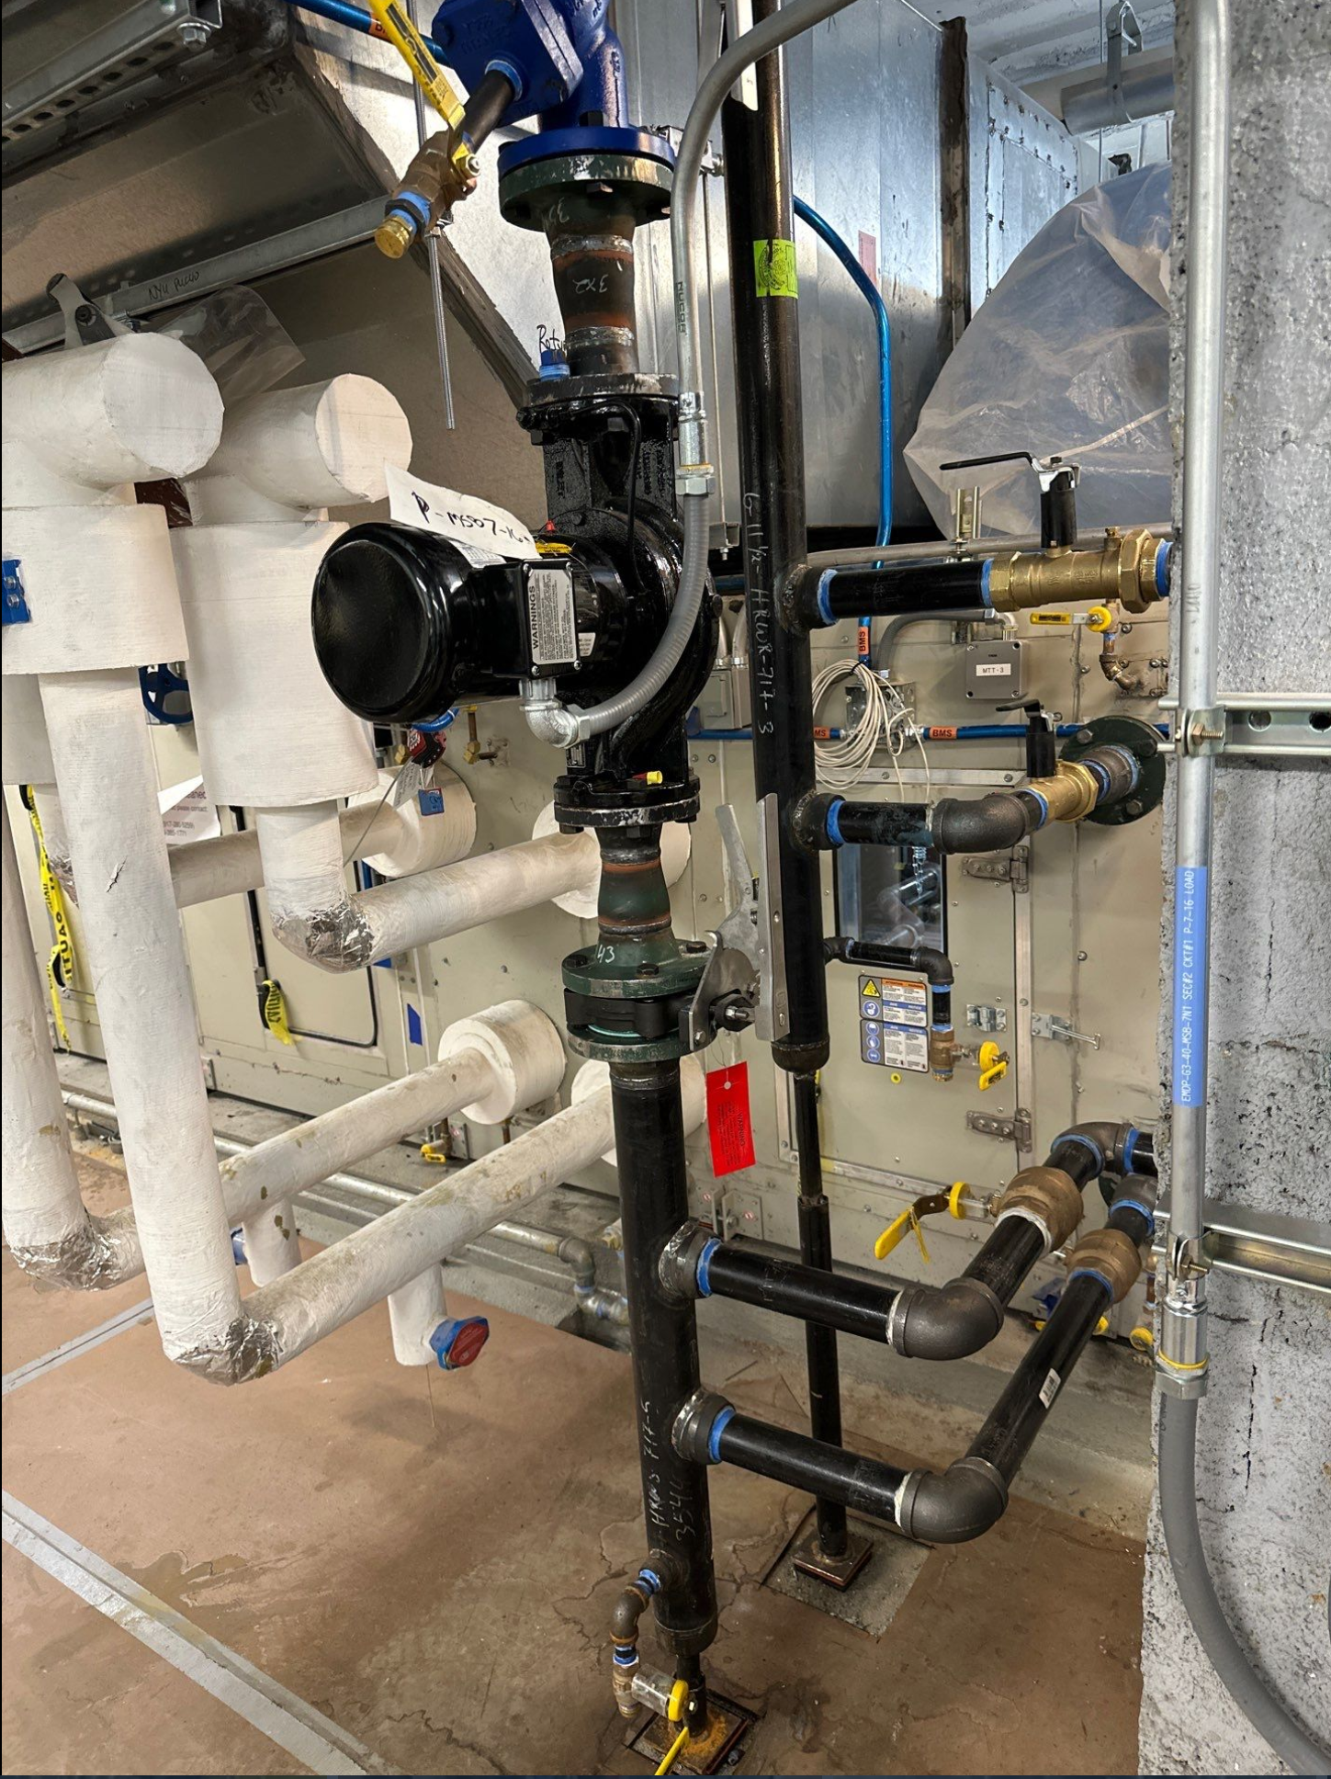
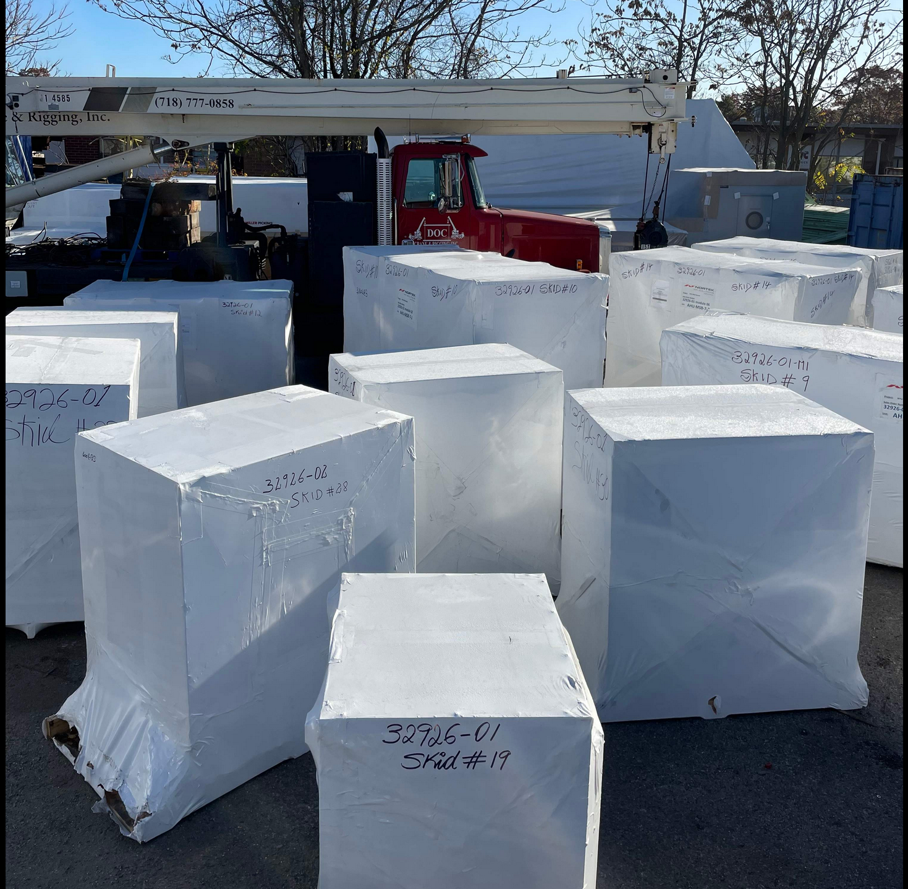
AHU-MSB-7-2
“Knock-Down” Construction
7 Modules
2 Fan Wall Sections – 7 Fans Total
8 Coils
Air to Air Heat Exchanger
“Run Around” Recovery Coil
Shipped in 33 Crates

Slide 15
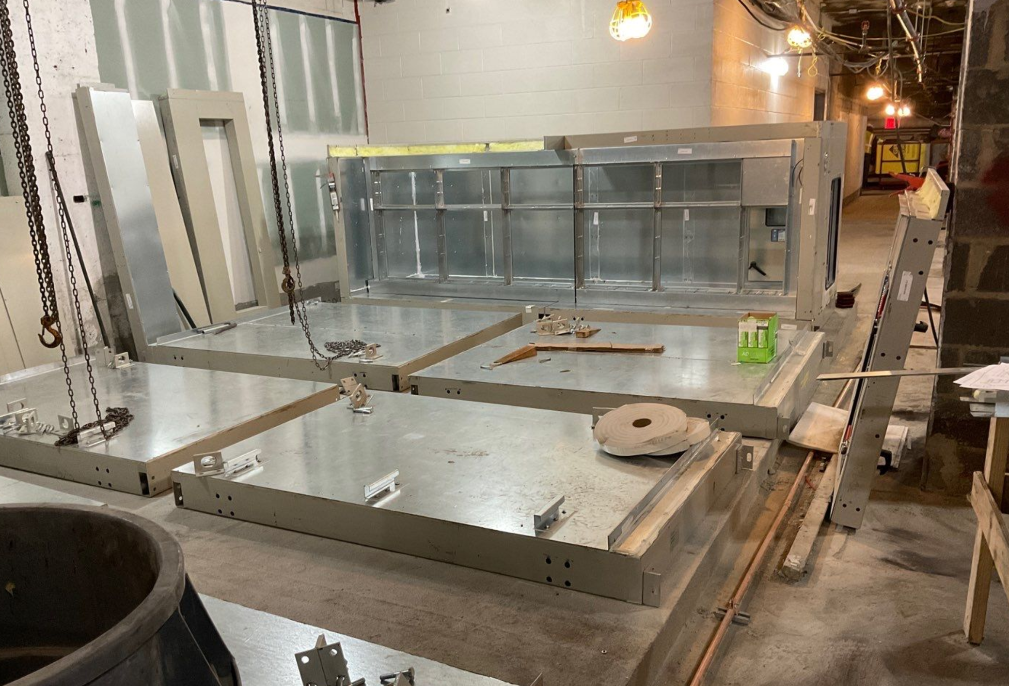
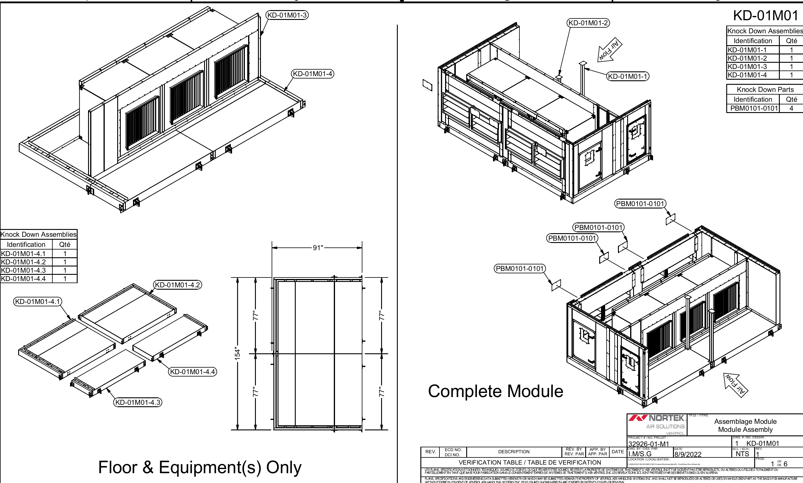
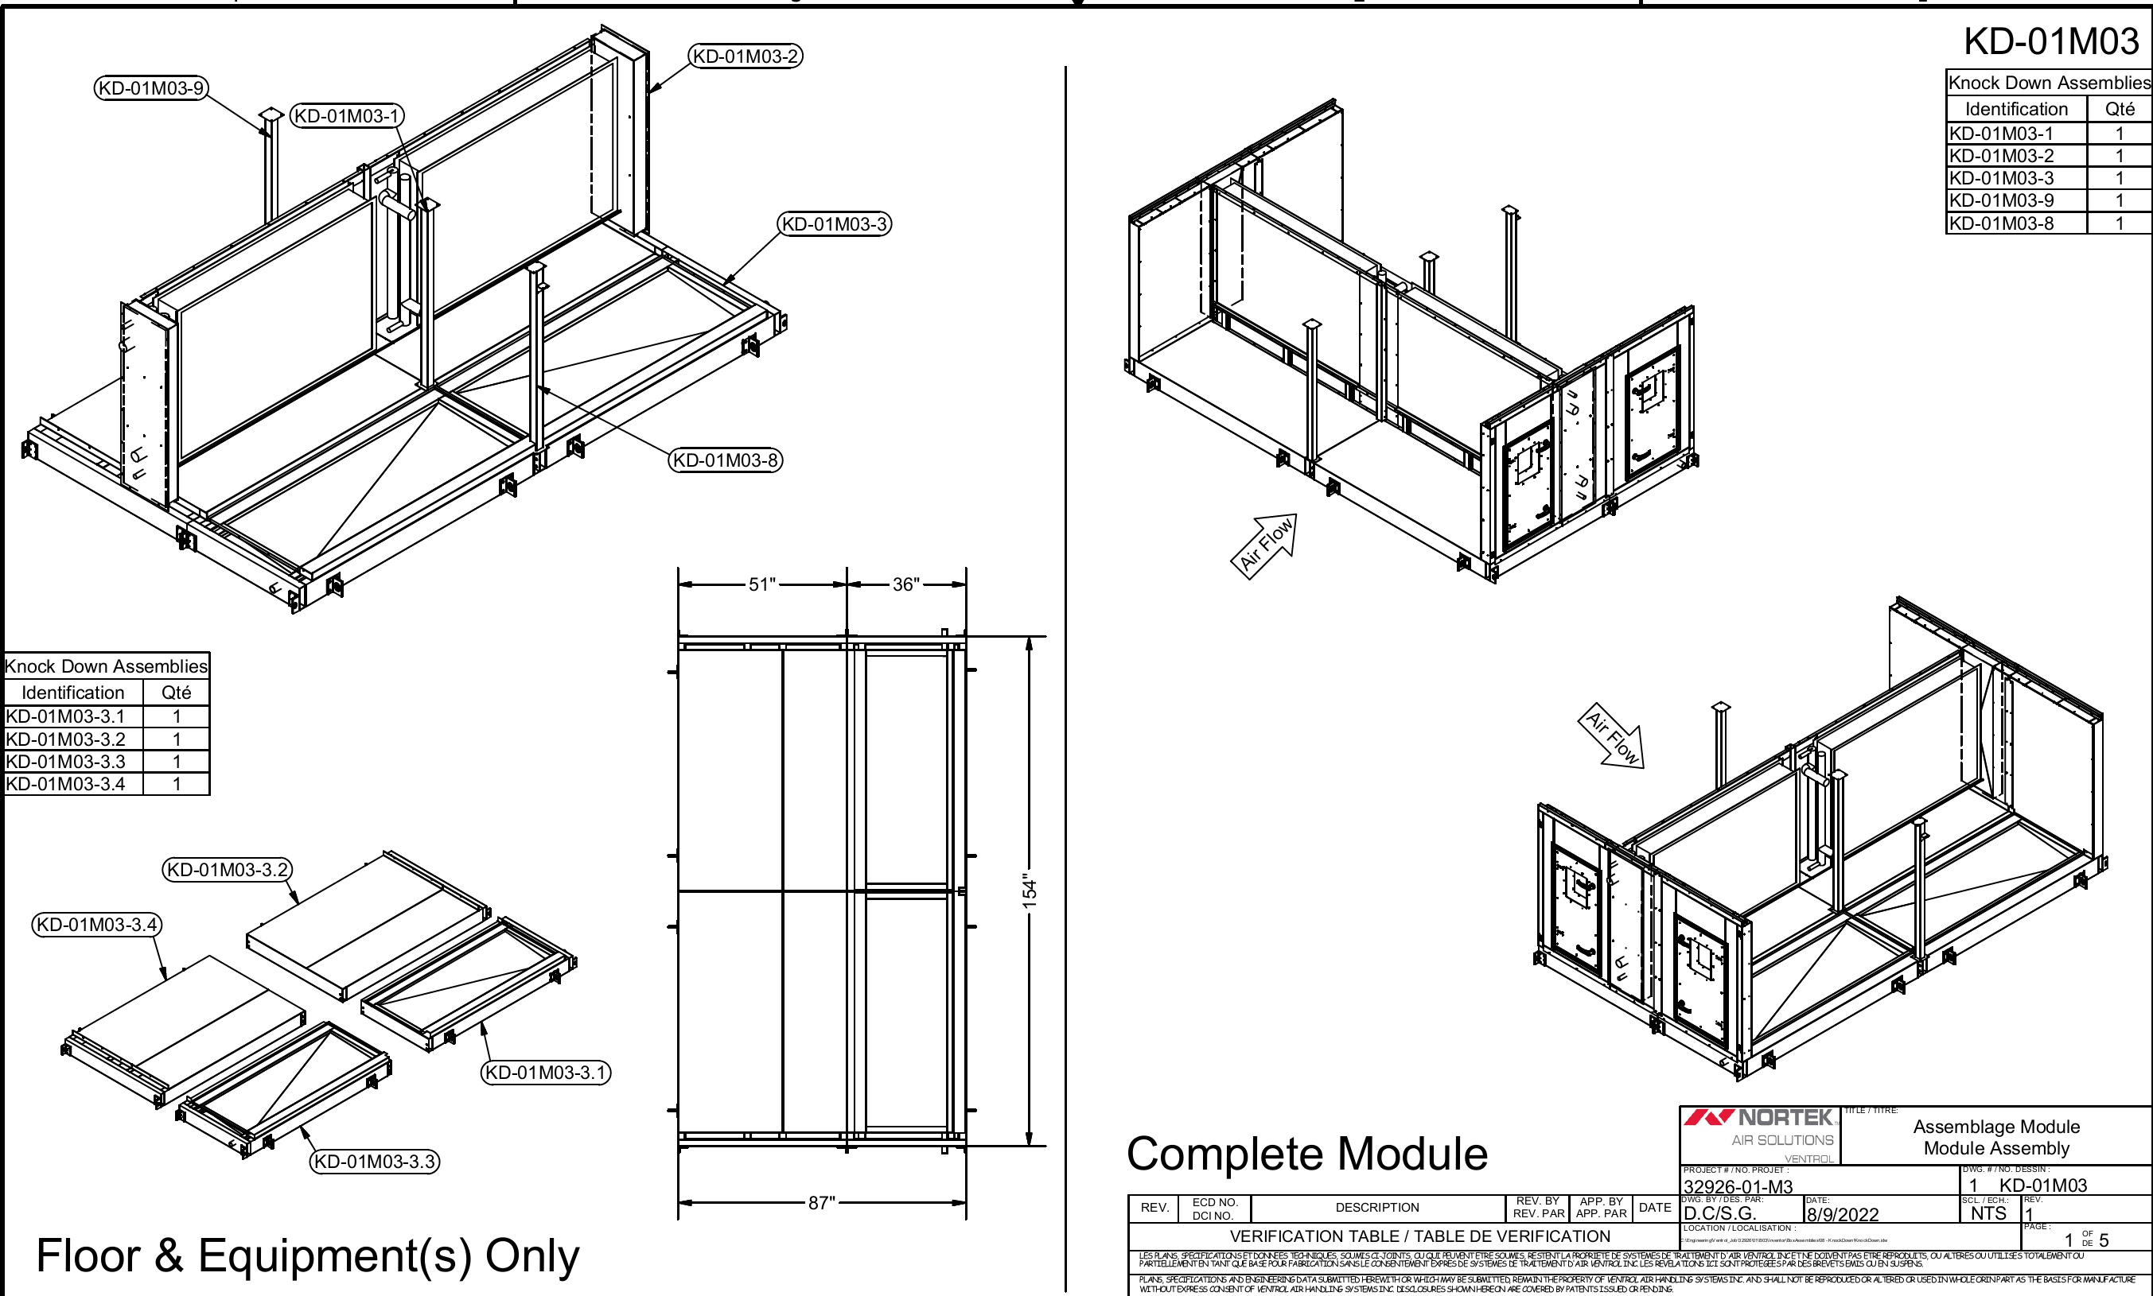
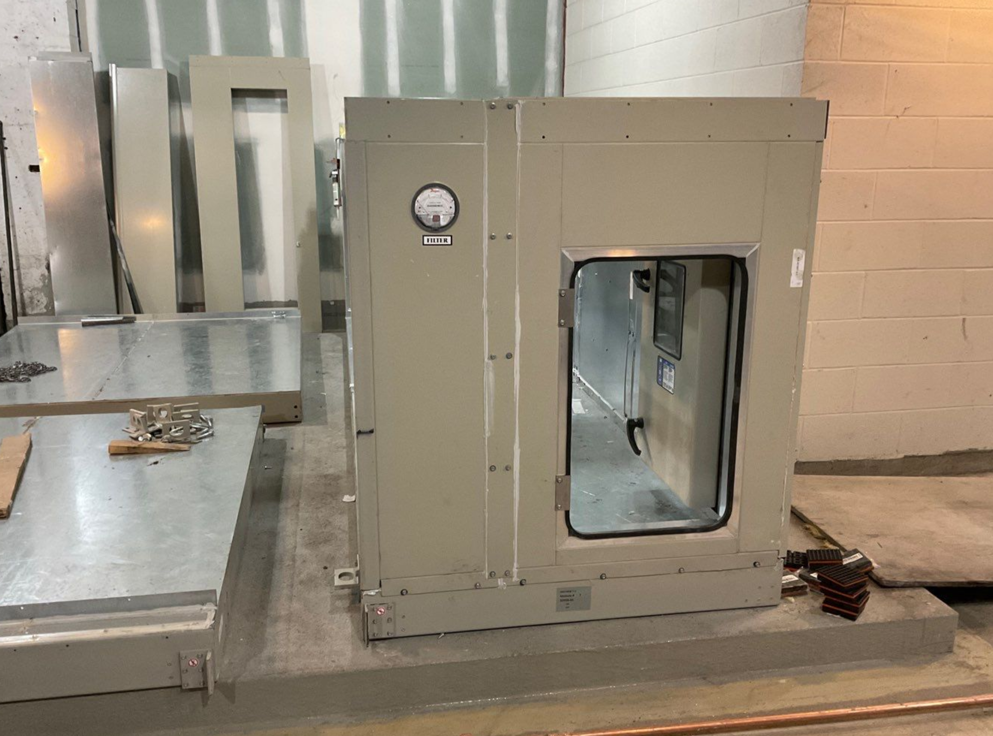
AHU-MSB-7-2

Slide 16
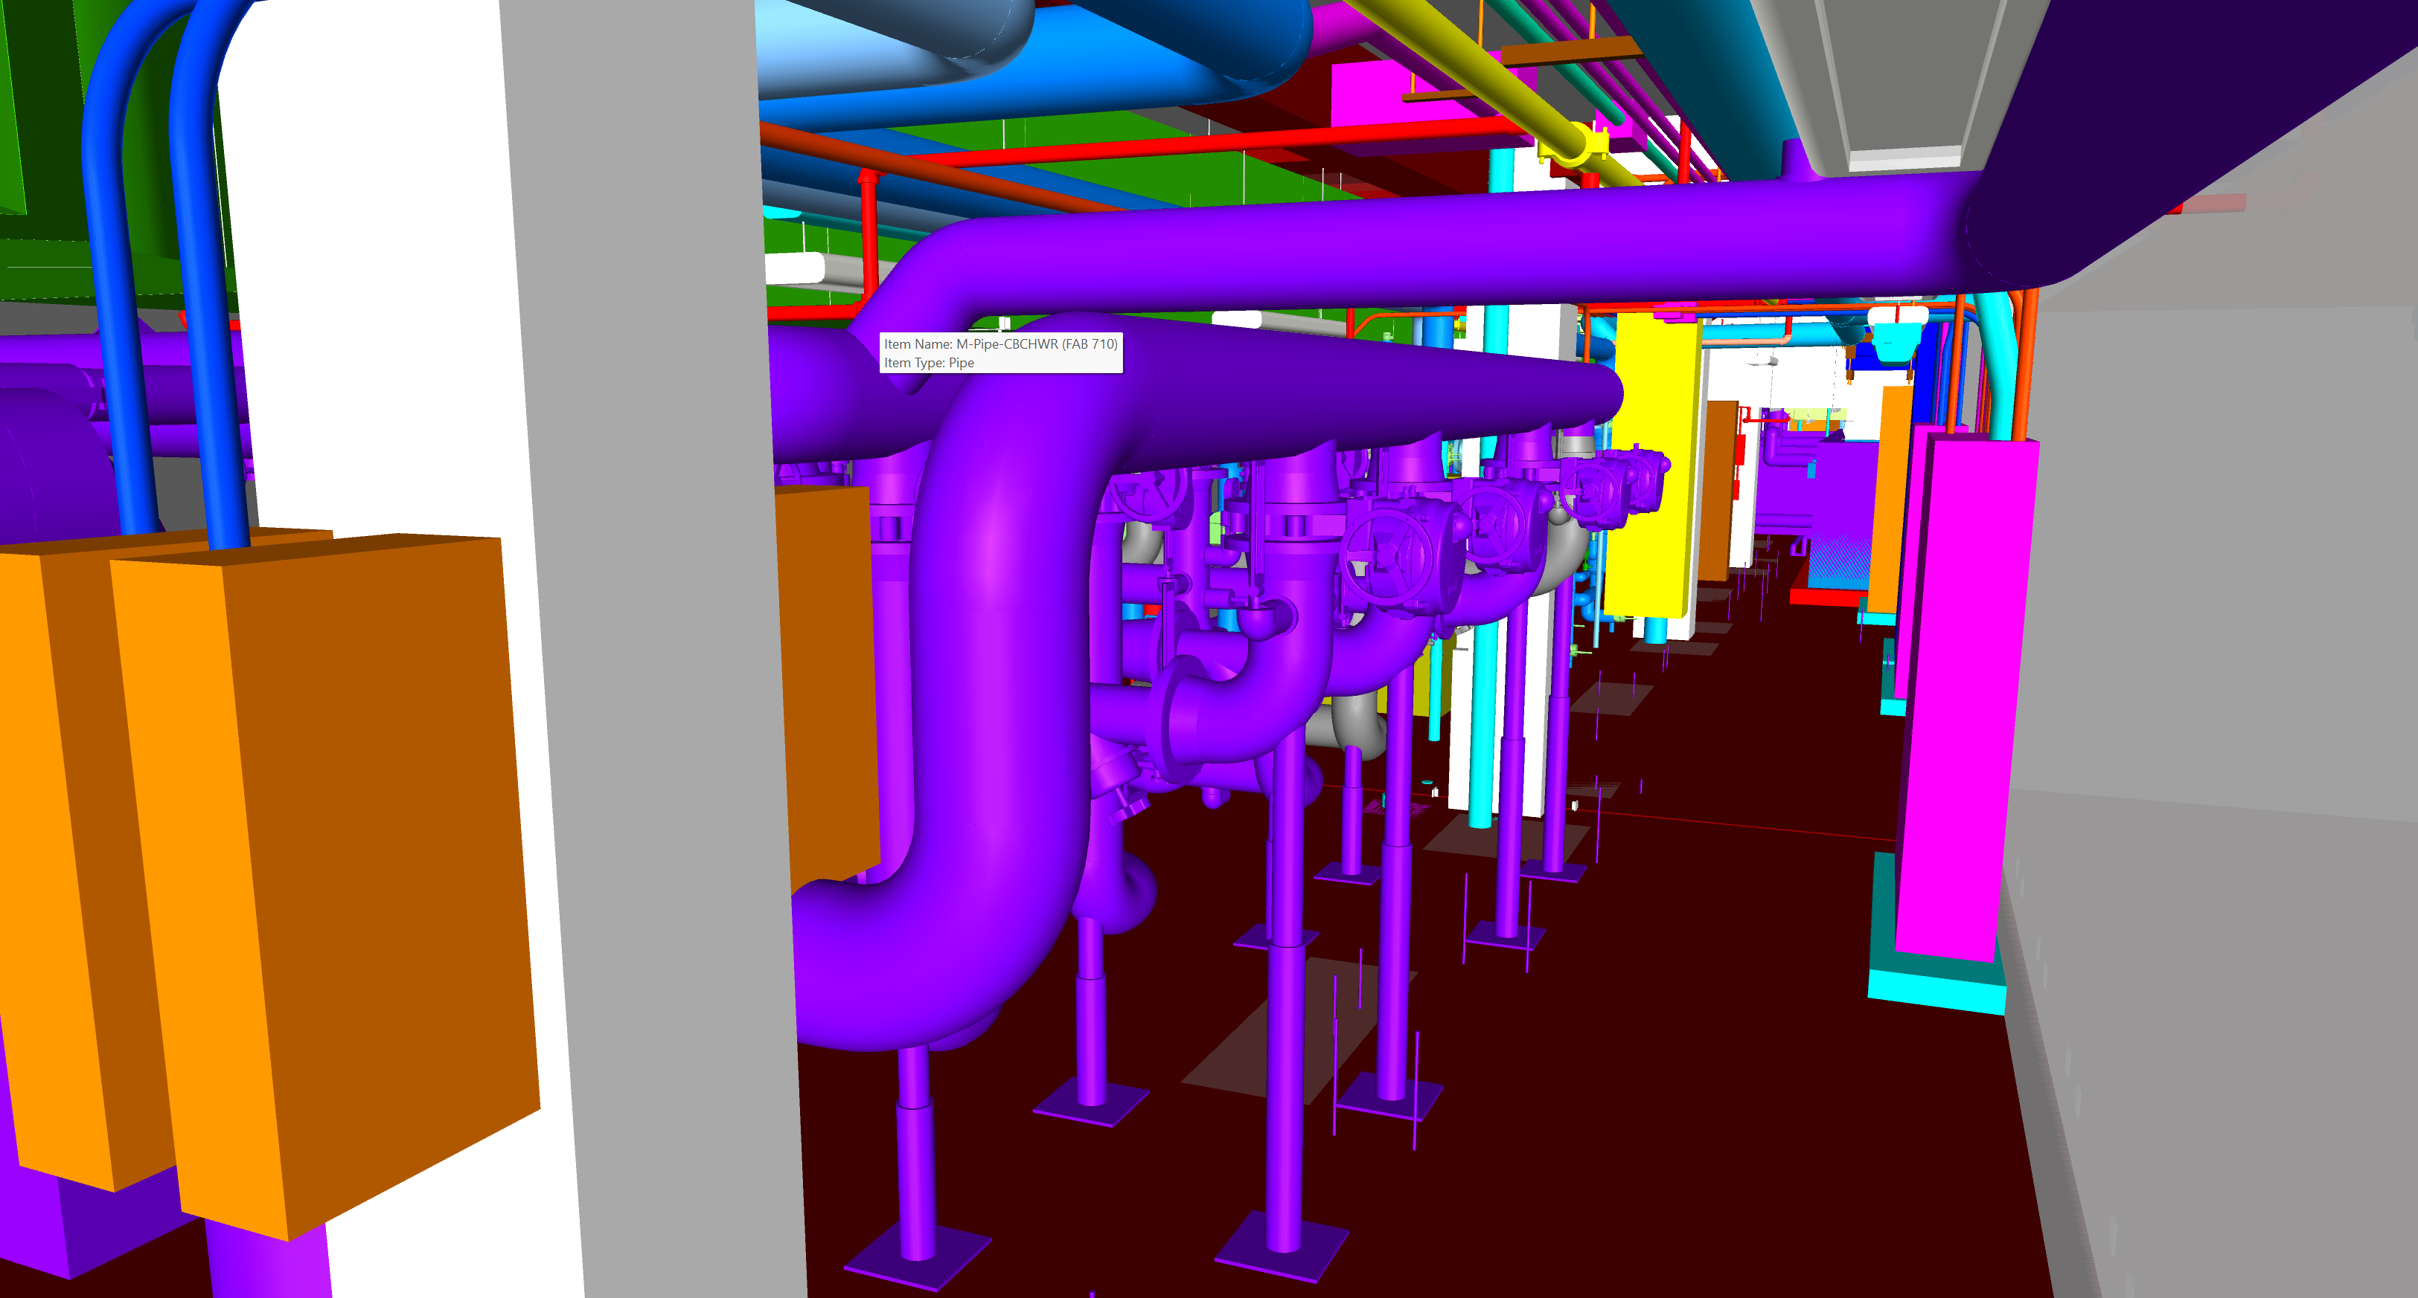
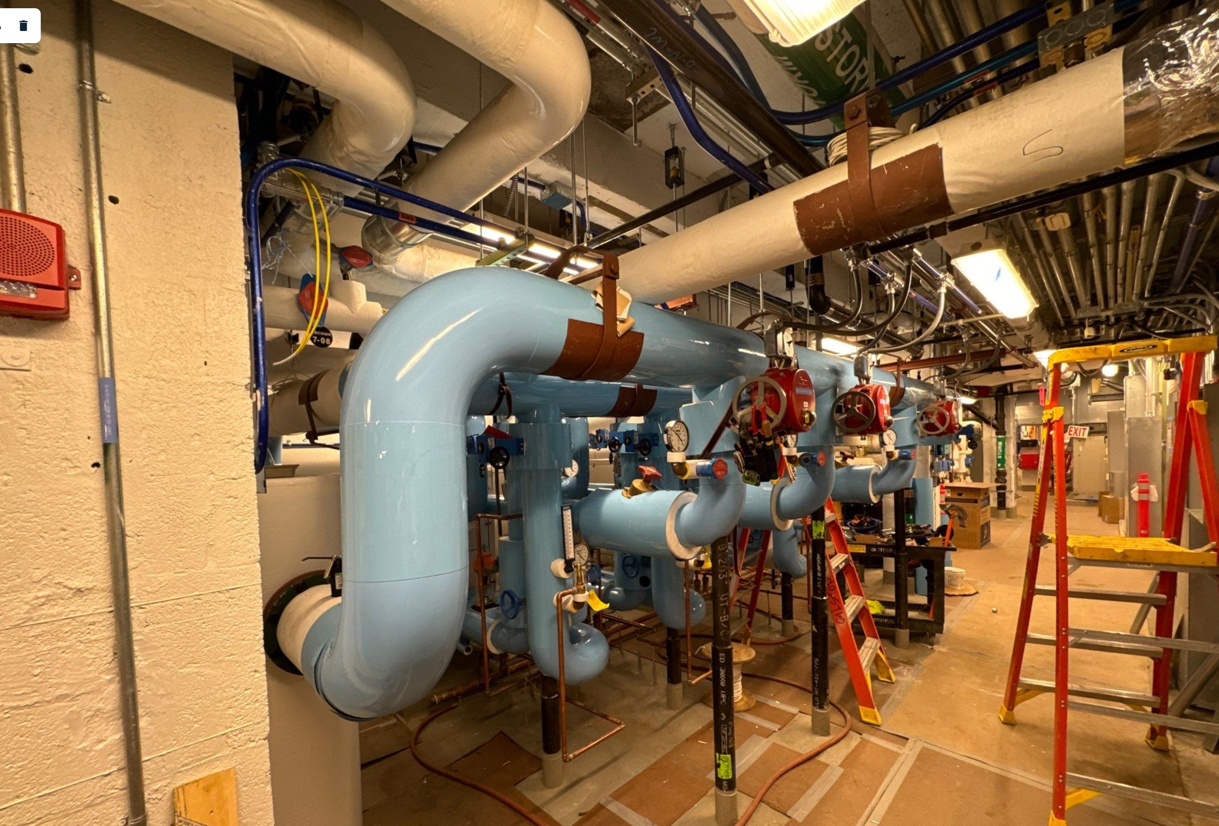
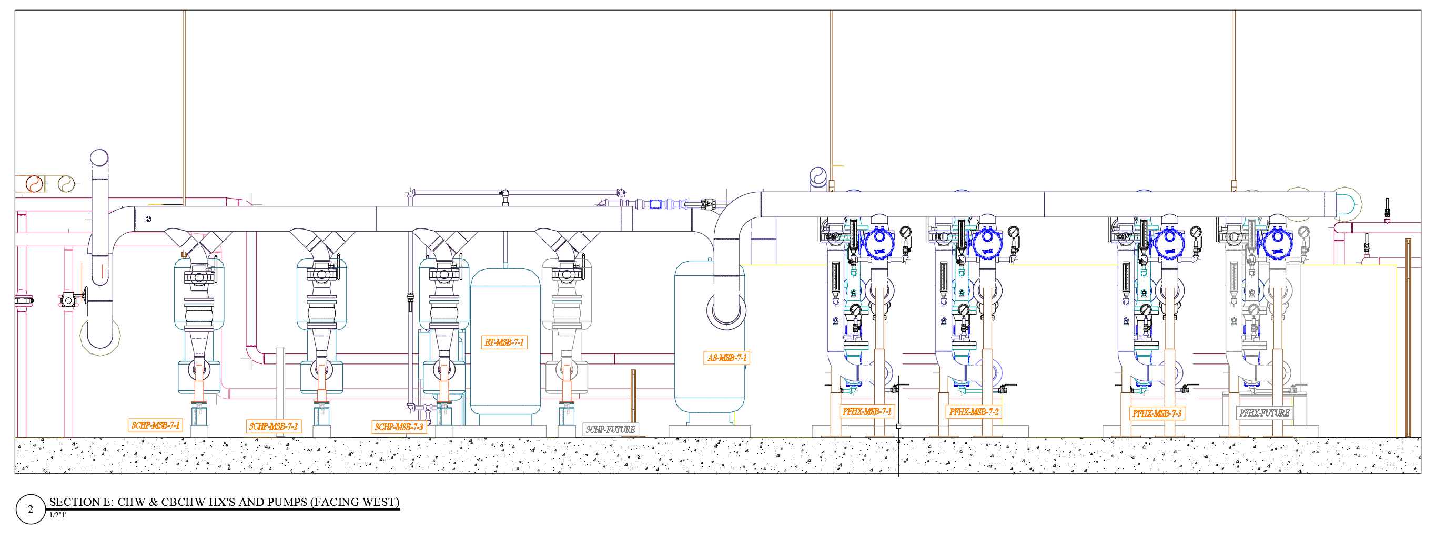
Chilled Beam Chilled Water Convert Campus chilled water to Secondary Chilled Water (SCHW) for the chilled beams Campus wide chilled water shutdown is required for in order to connect

Slide 17
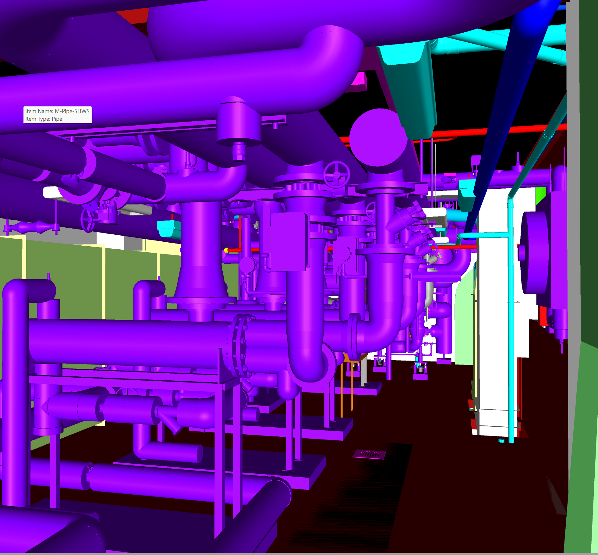
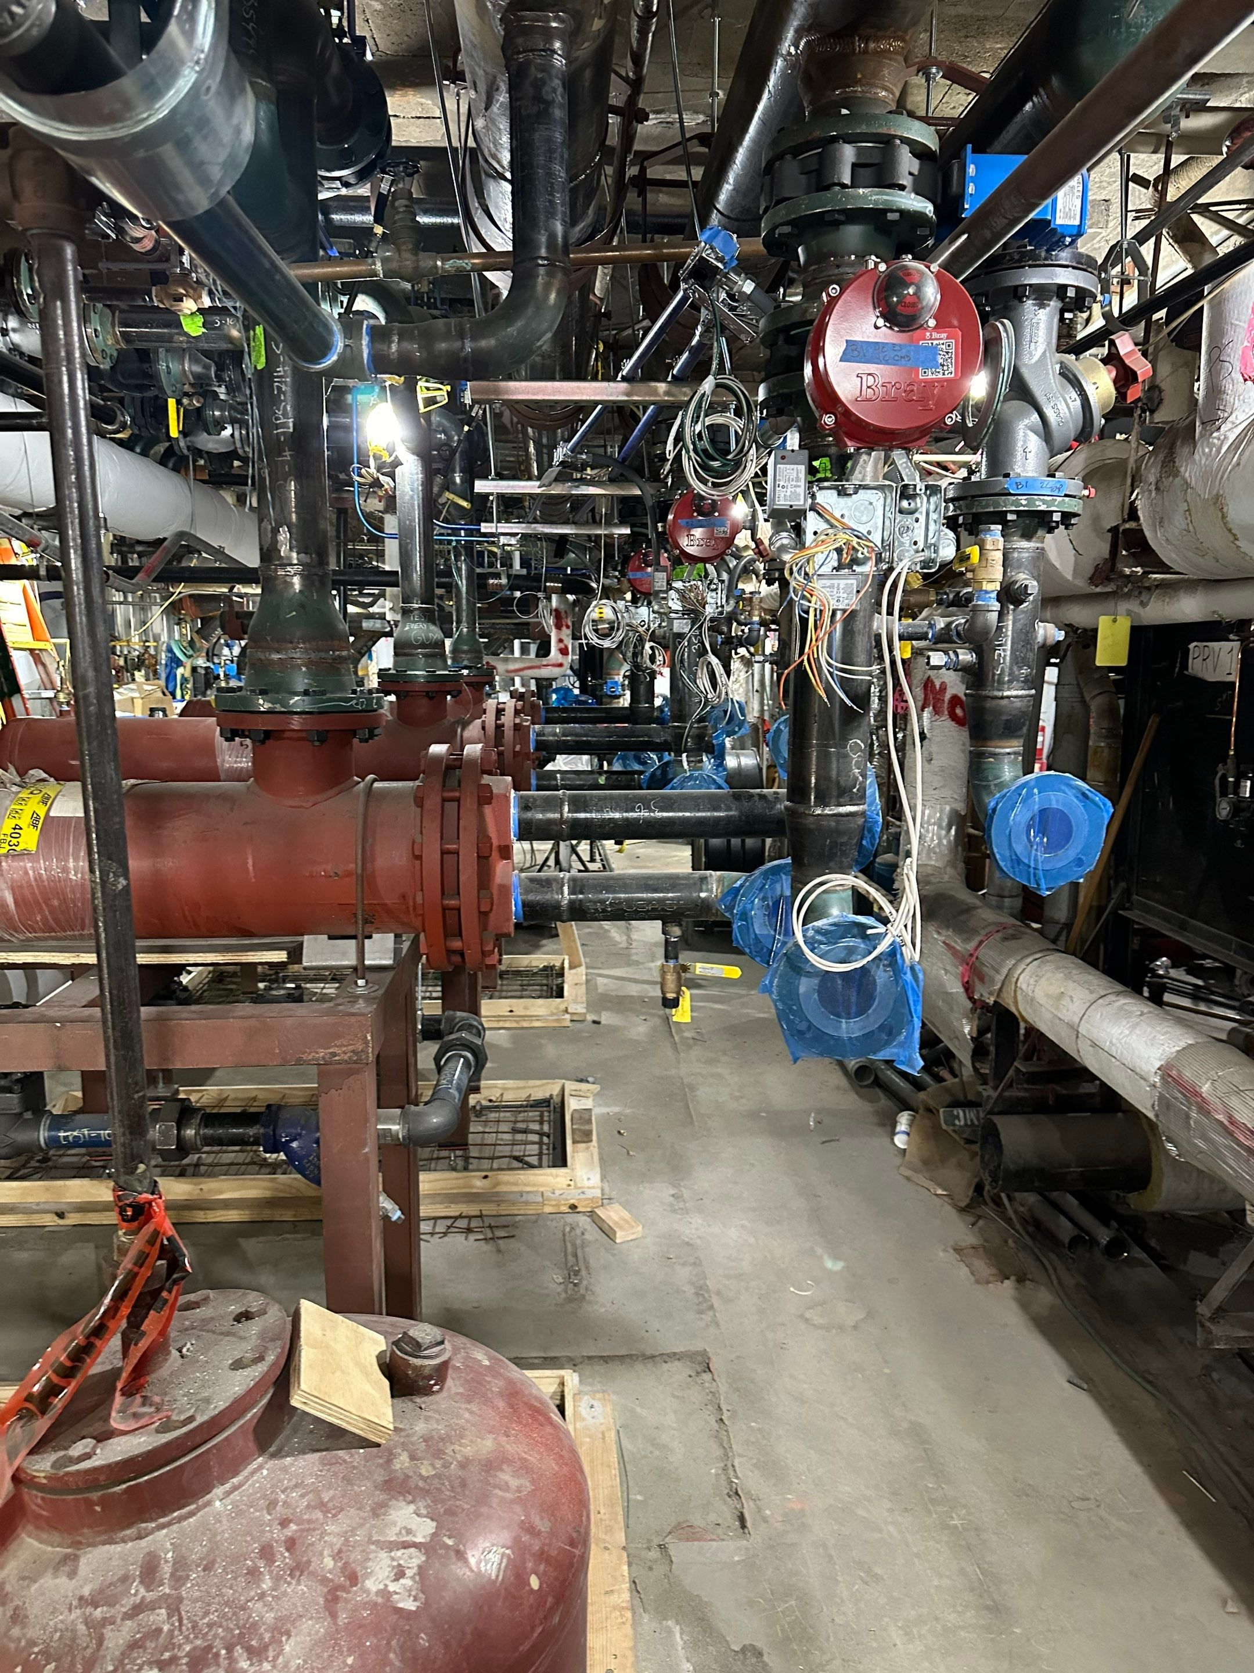
Secondary Hot Water Heat Exchangers
Low Pressure Steam from PRV Station used to make Secondary HW with a design temp 105°
The condensate is returned to central plant for re-use

Slide 18
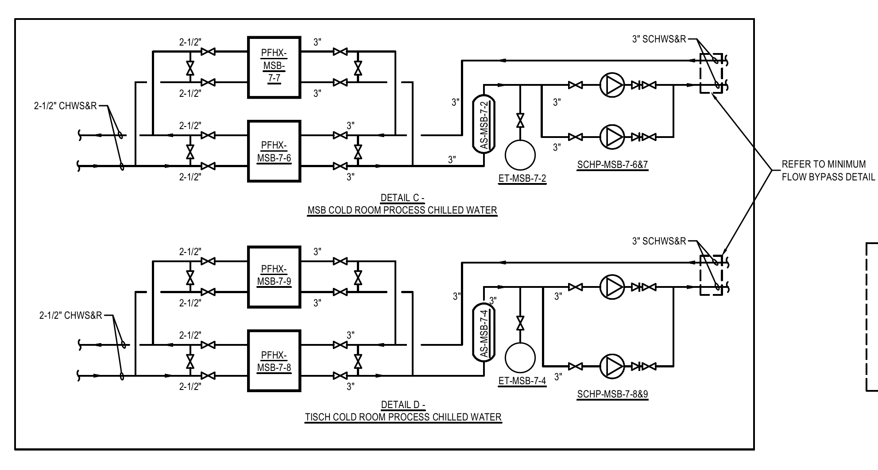
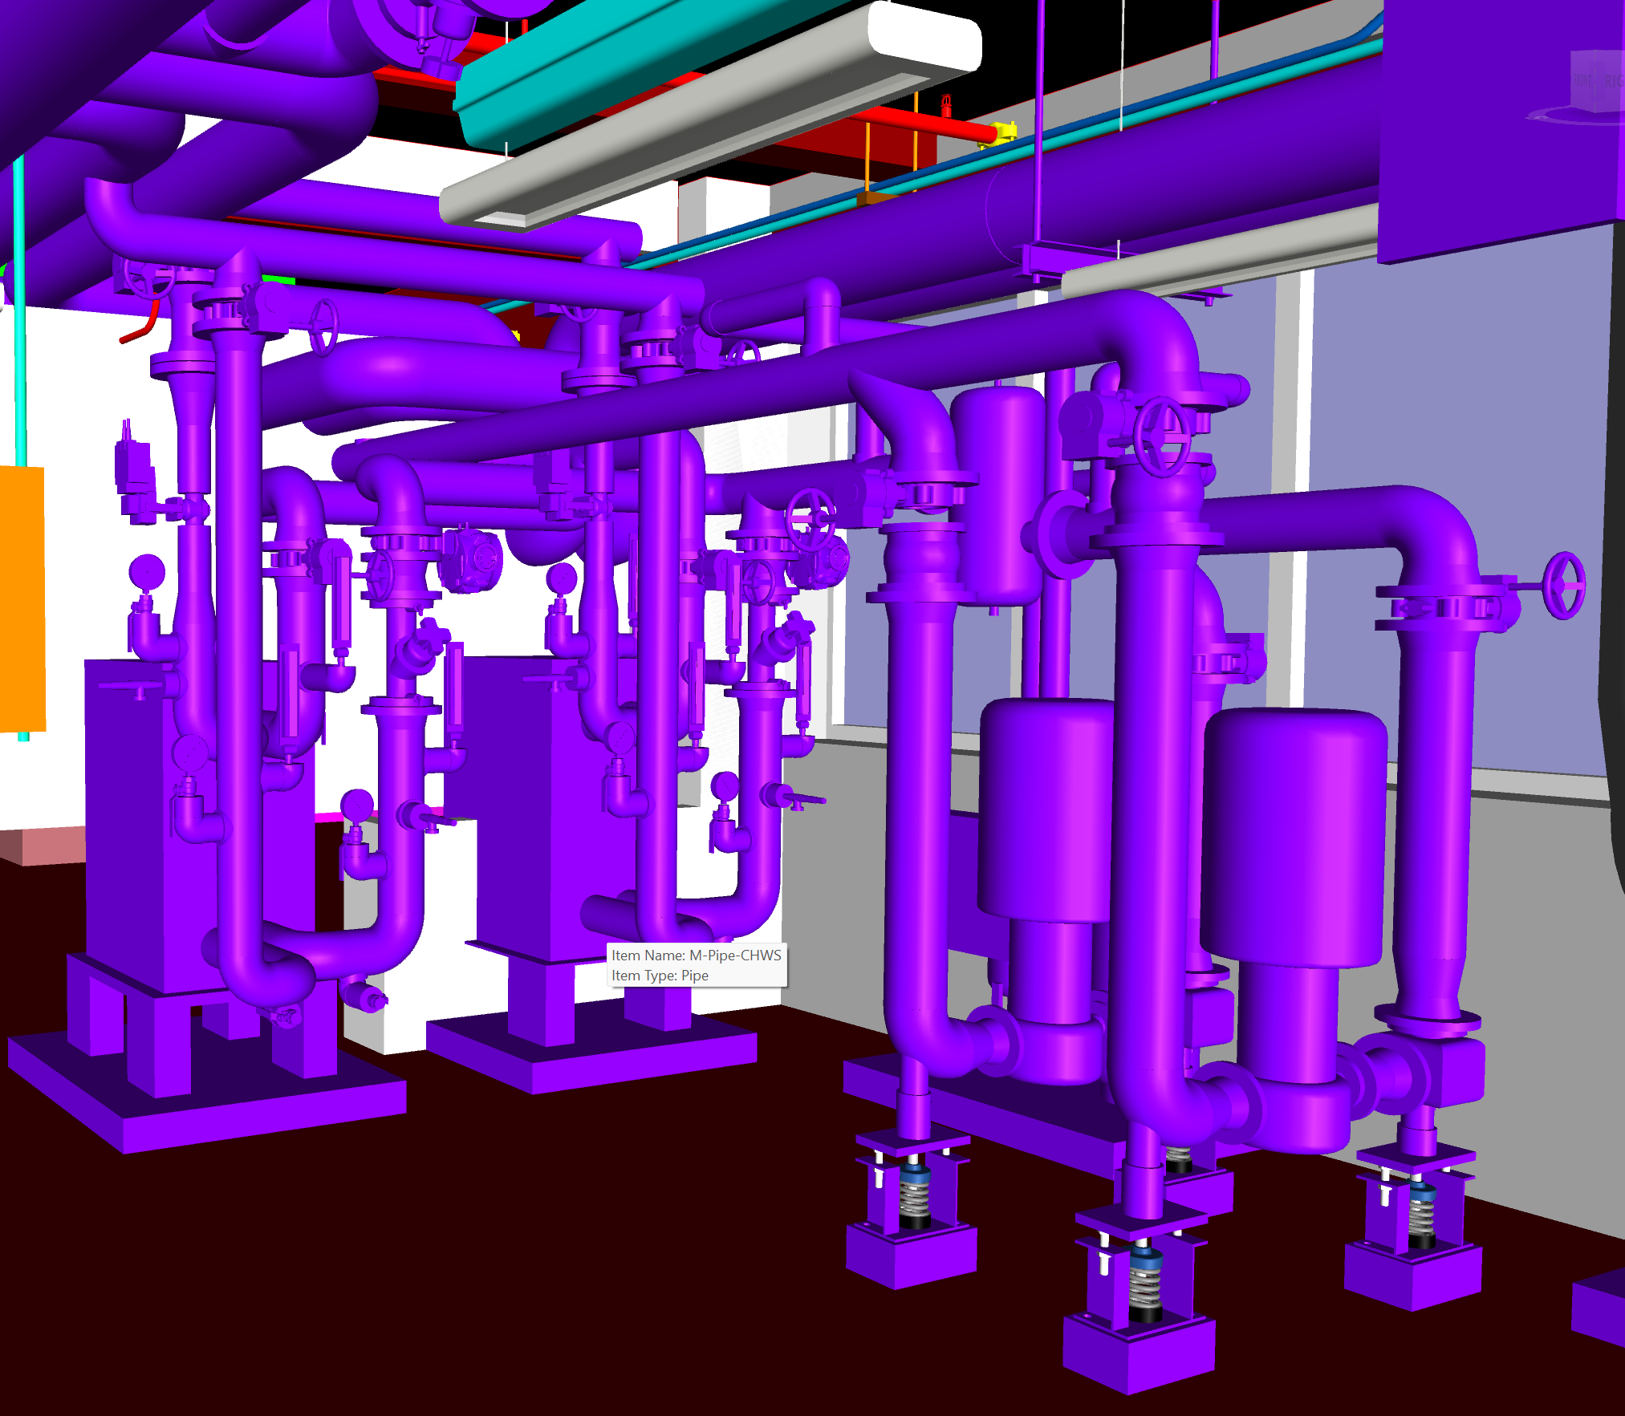
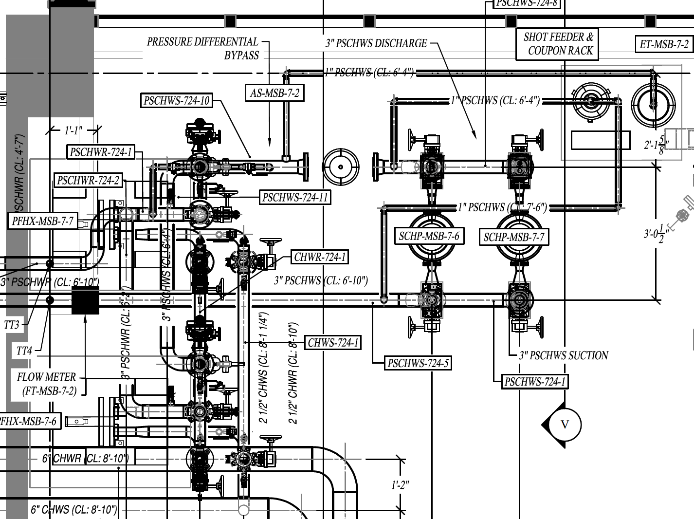
Secondary Chilled Water
Campus Chilled Water converted to Secondary Chilled Water through Plate and Frame Heat Exchangers. New pumps to provide Secondary Chilled Water to existing Cold Rooms

Slide 19
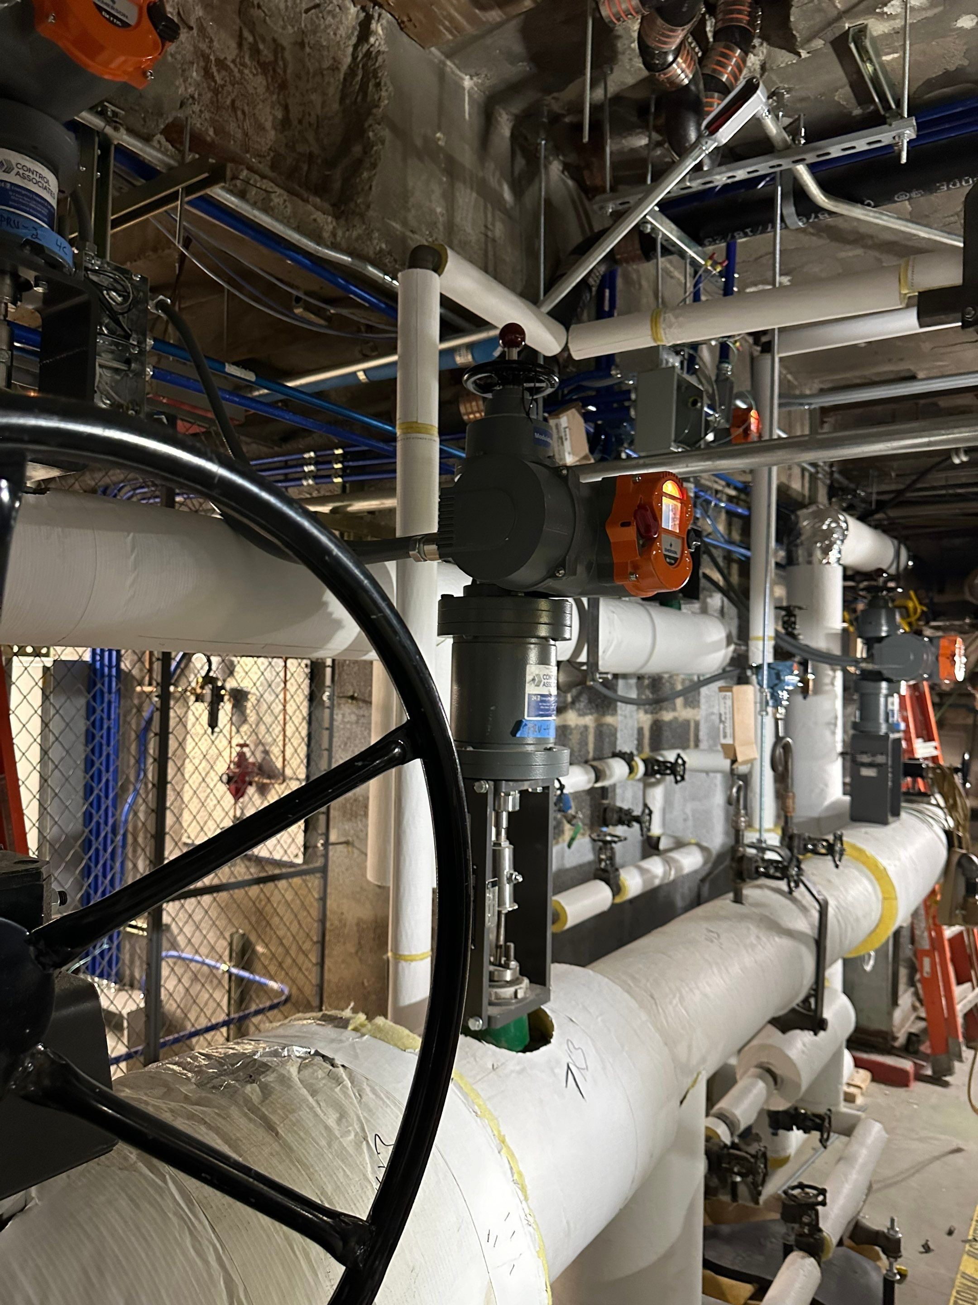
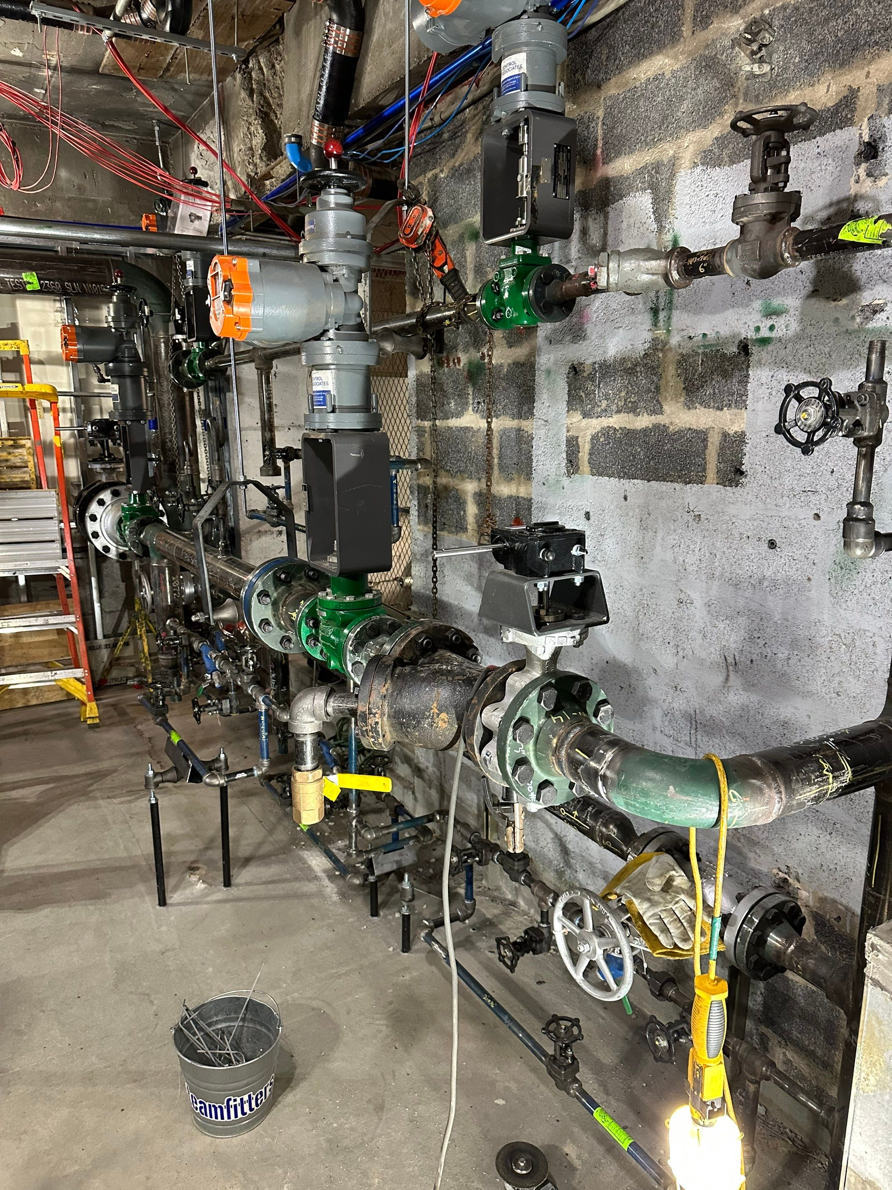
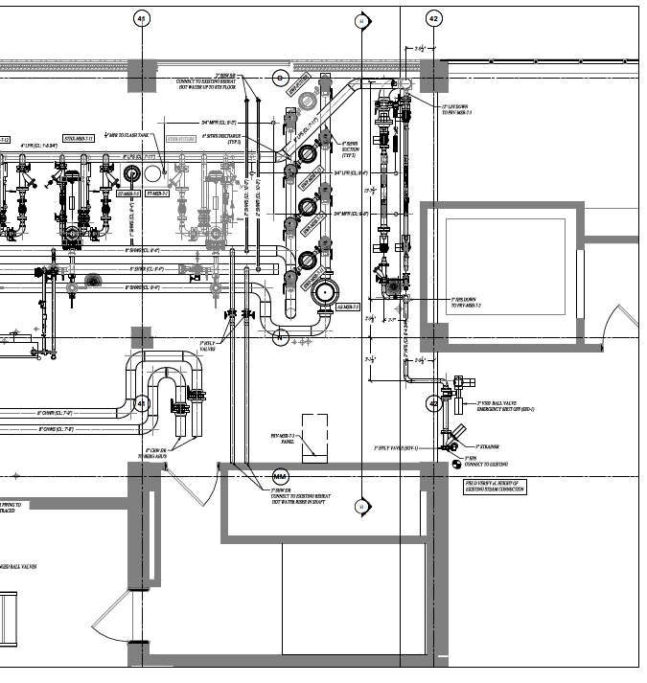
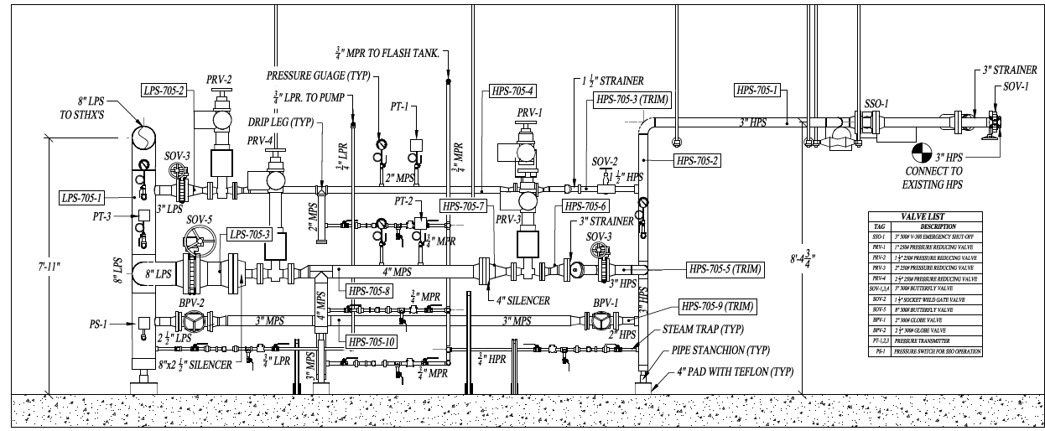
Steam PRV Station High Pressure Steam (150psig) converted to Low Pressure Steam (15psig) X-Ray Welding X-Ray’s required inside working hospital Campus wide steam shutdown required

Slide 20
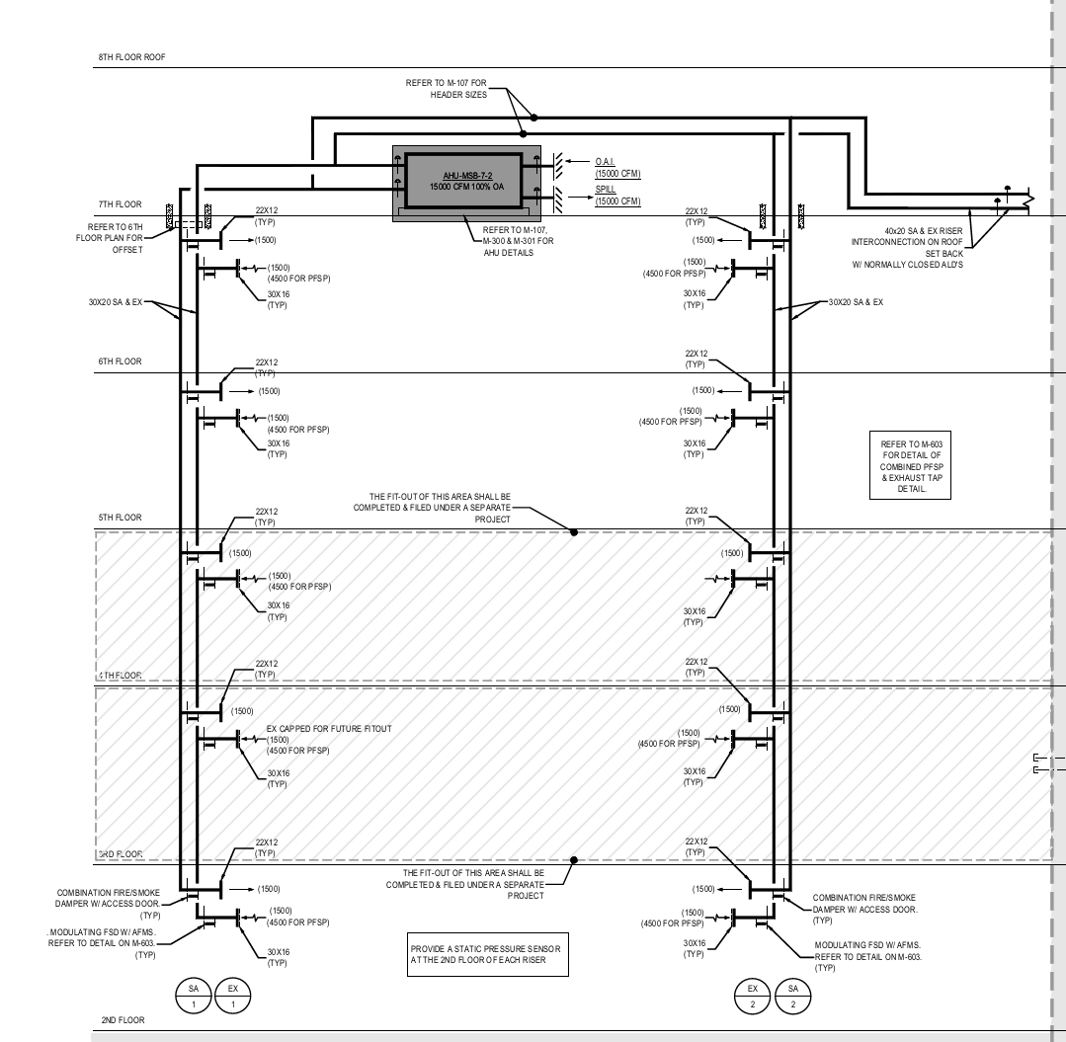
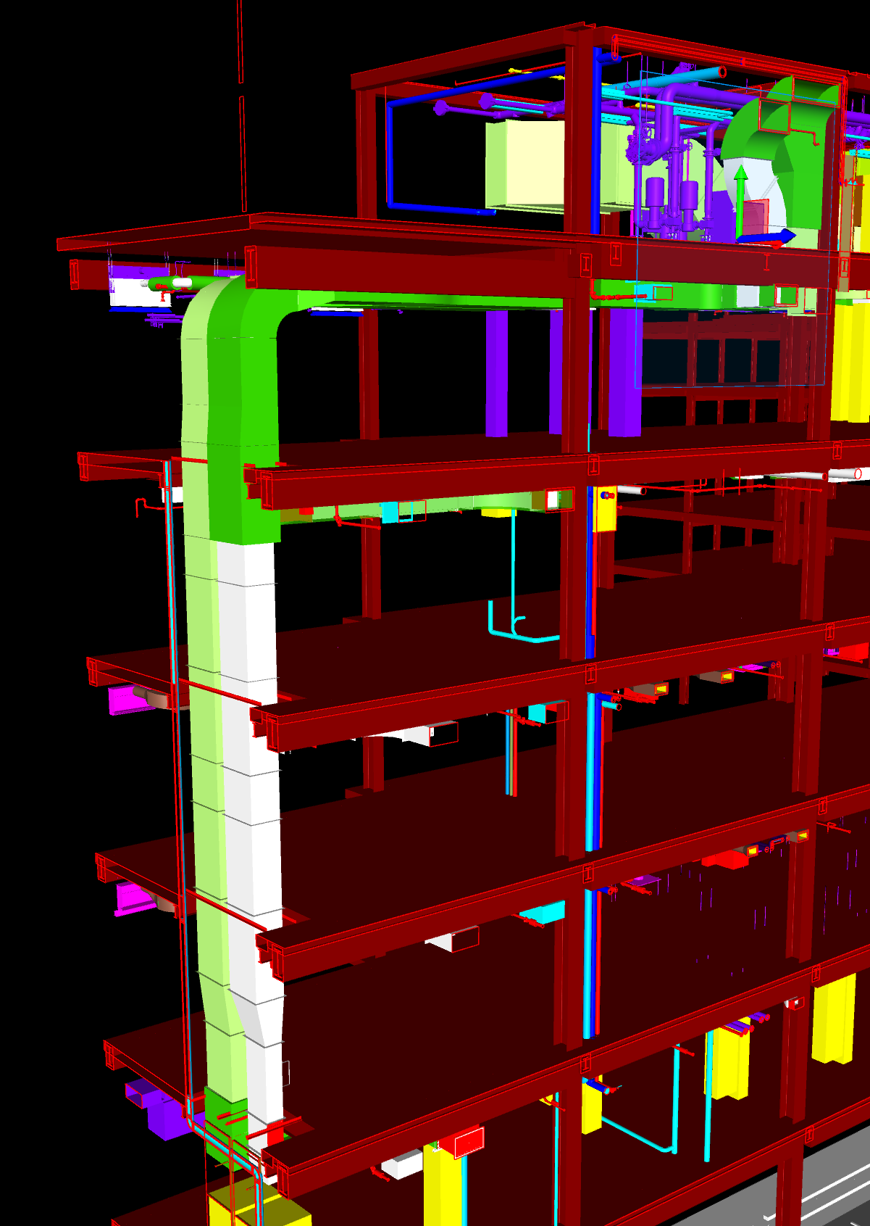
AHU-MSB-7-2 Air Risers
North Duct Risers
6th Floor must be fire-wrapped
Takeoff provided on 2nd to 6th floor

