Slide 1

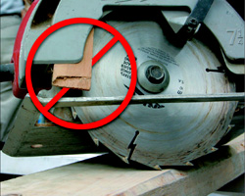
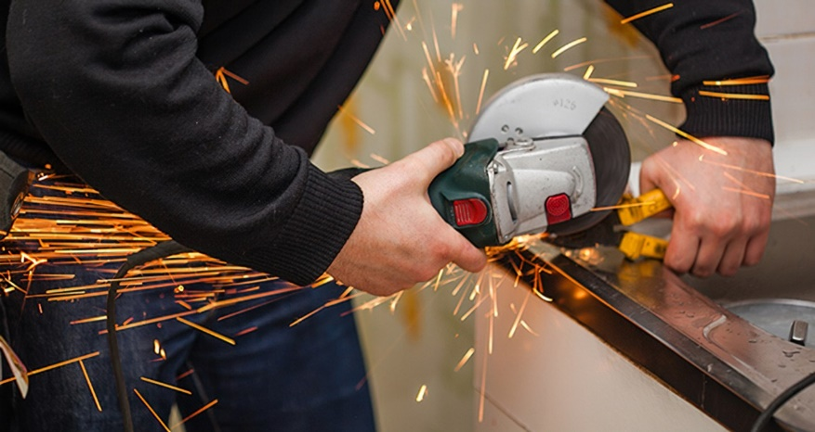
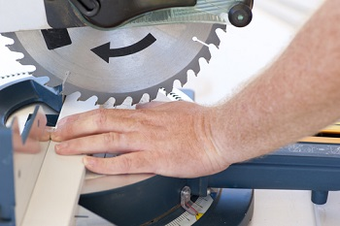
Hand Incident Prevention
Know the risk Factors:
Trade Professionals are subjected to laceration and hand injury hazards in most work environments. Hand placement during tool use is a contributing factor to hand incidents during power tool use. Understanding the tool, and proper setup are key to having a safe work environment. When using a tool, use guards as designed, and never alter the guards beyond design. Keep hands a minimum of 6 inches away from moving parts and keep clothes and gloves away from the blades. Use the 2nd handle on all tools that are outfitted with them. Inspect tool before each use.
Please discuss this with your crew and ask them to identify 5 hazards and precautions associated with Hand Injury Prevention using power tools, then flip the page over and see if they identified the same things as we did. Challenge them to identify the hazards before flipping this over.

Slide 2
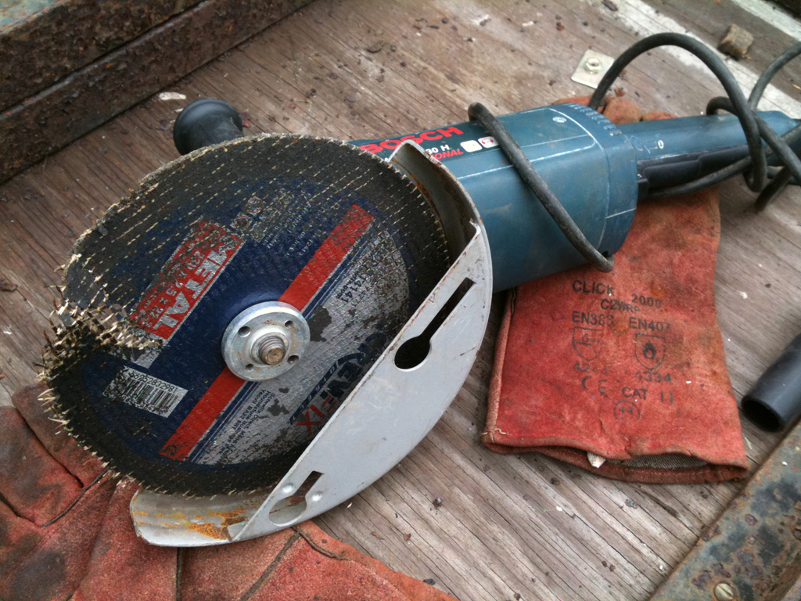
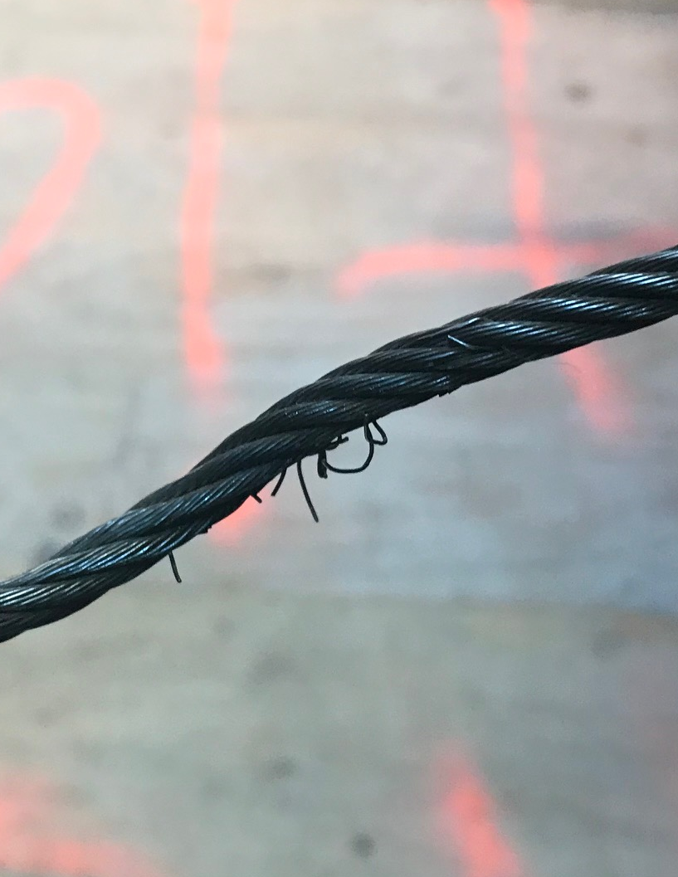
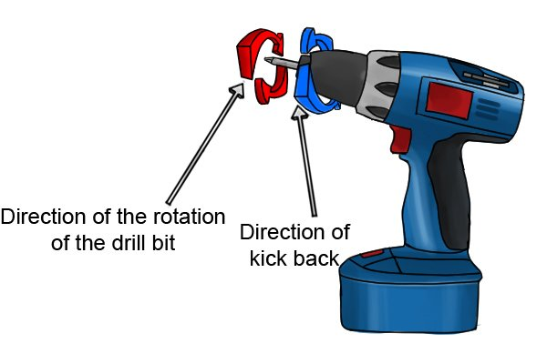
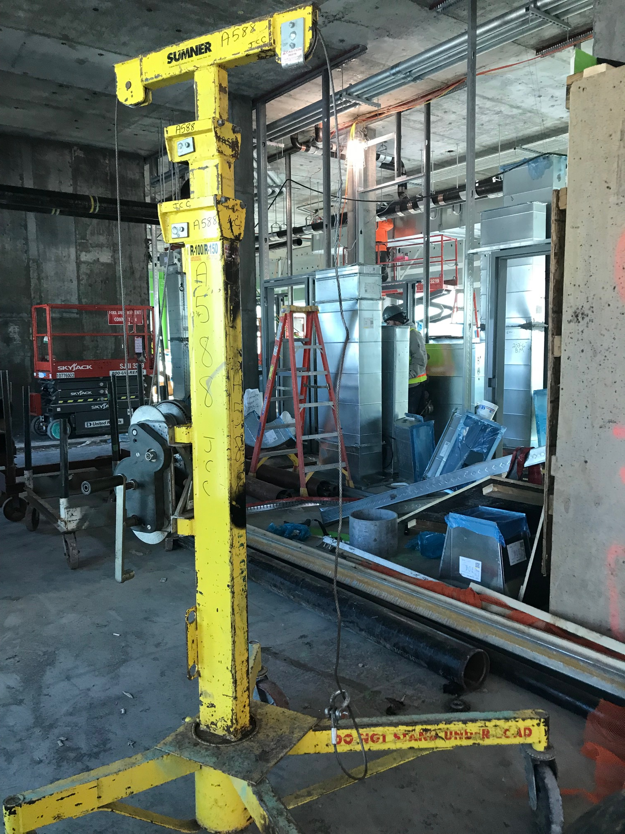



Topic: Hand Incident Prevention – Power Tool Use
Inspect the disc to ensure that it is safe / undamaged, the 2nd handle is available, and the guard set for the operation.
Wear the correct PPE when using a grinder (correct type of glove, glasses, and secondary eye protection).
Inspect all parts of any tool used for hazards that can cause a laceration / injury
Kick Back Hazards can exist while using drills. Follow Manufacturers specs and 2nd handle during use to avoid this hazard.
2

Slide 3
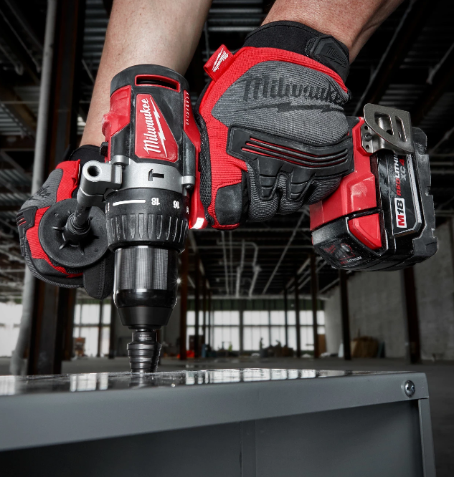
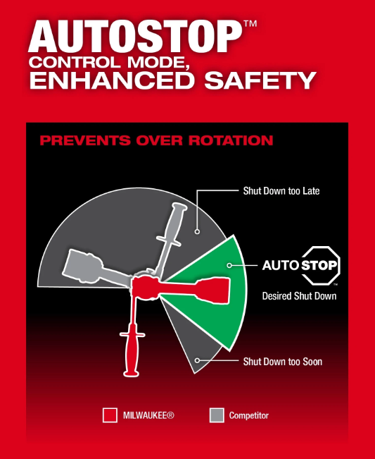
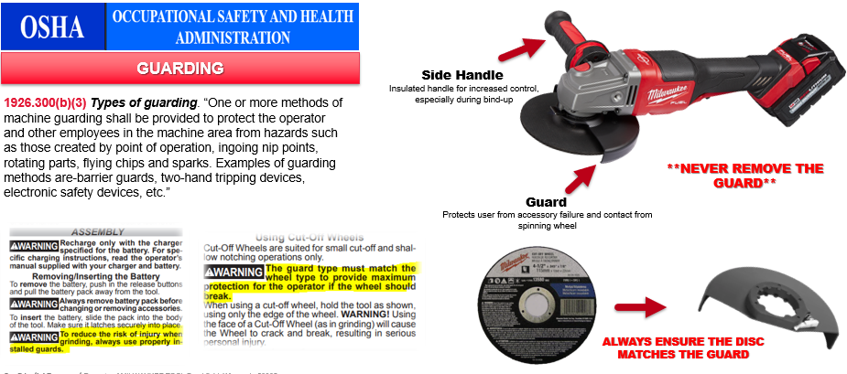
Recap
Topic: Hand Incident Prevention – Power Tool Use
Using a 2nd handle and / or using Autostop can help reduce kickback hazards.
3

Slide 4

Recap
Project: |  | Supervisor
Date:
Topic: Hand Incident Prevention – Power Tool Use
Hazards | Precaution
Cut / Laceration hand Injuries. | Boots on the land / gloves on the hand – Wearing gloves while using power tools can often cause a risk if they are the wrong size. Glove fingers should be snug at the ends and having additional material (to long of fingers on gloves) can cause a cut hazard of the glove being grabbed by a blade. Hand placement is key.
Hand Laceration from power tool | Inspect tools before use – ensure proper blade / disk is used. Make sure blades are sharp on both tools and knives. Always keep you hand away from the blade during use, secure materials prior to cutting them with a tool, have proper training for tool use, ask for help when needed to secure materials. Remove battery / unplug prior to completing maintenance on a tool.
Uncontrollable Force Injury from a Power Tool | Keep hands, face, arms, and body out of the line of fire of blades and uncontrolled tools. Uncontrollable tool hazard exist in the event the tool is bound up and causes injury to the end-user. Setting a tool on the highest setting without engaging the AutoStop technology or using the tool without the 2nd handle is not recommended. The 2nd handle that comes with a tool helps the end-user control the tool in kick-back or bind-up hazard scenarios and allows for maximum control of the tool.
Hand injury due to work access. | When accessing the area, you're working in – have adequate lighting. Make sure the area has good access for proper setup and use of the tool in your operation. Use auto-stop or rapid stop technology tools to reduce this hazard. Acknowledging hazards of kickback / bind up hazards in your plan will help the job team with hazard identification. Does my access-way provide good use of tool? Setup the work area to prevent others from accessing the area while using tools to prevent accidental bumping while using tools.
Crew Member’s Names

