Slide 1

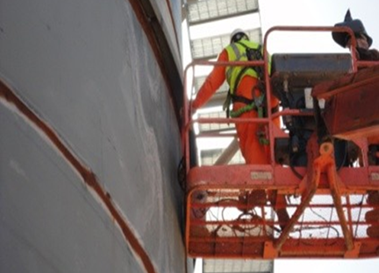
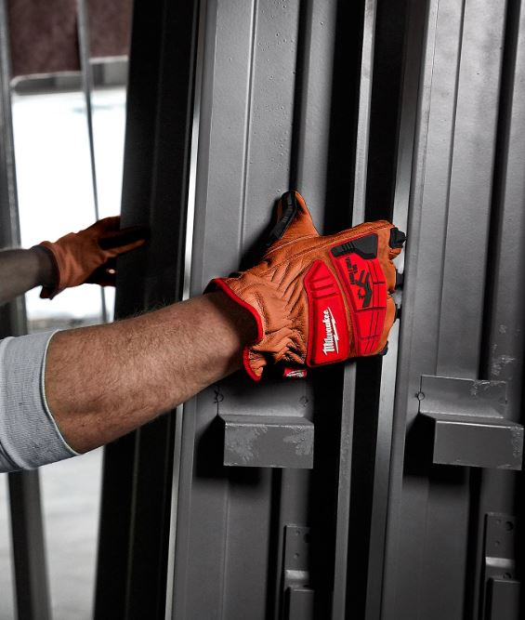
Hand Incident Prevention
Know the risk Factors:
Trade Professionals are subjected to hand injury hazards in most work environments. They can be eliminated often by planning processes and engineer controls – however the most important part of elimination is recognizing the pinch points / cut hazards associated with your work and the surrounding environment. Material Handling and hand placement during deployment operations are crucial. Situational awareness can be a great start in eliminating hand injuries. Wearing PPE 100% of the time for un-foreseen circumstances during material handling operations is a must!
Please discuss this with your crew and ask them to identify 4 hazards and precautions associated with hand incident prevention focused on material handling hazards , then flip the page over and see if they identified the same things as we did. Challenge them to identify the hazards before flipping this over.
Keep hand inside lift while in operation, flex on the boom creates pinch points.
Pinch Points

Slide 2
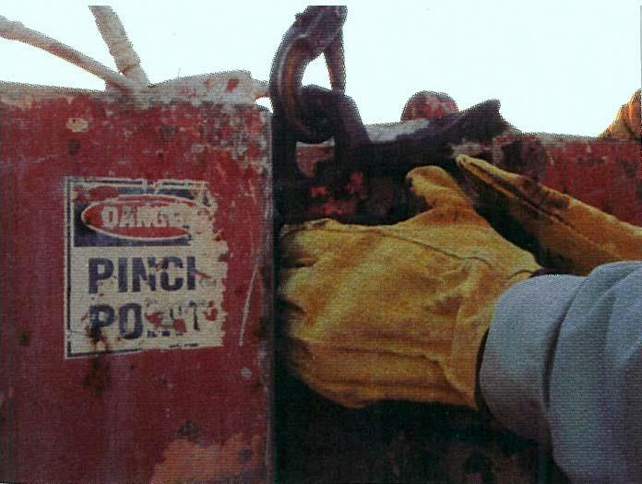
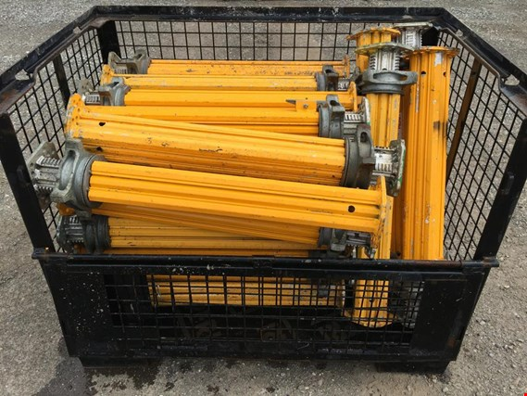
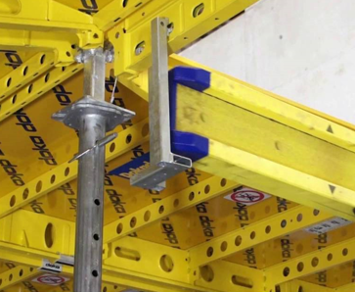



Topic: Hand Incident Prevention – Material Handling
Identifying Pinch Points and communicating them is top priority for hand incident prevention.
Spaces between the fittings are pinch points when tightening with hydraulic or battery-operated tools with hands close to gaps.
Wear the correct gloves for specific hazards / avoid creating a hazard.
Avoid Complacency when stacking material in crates to avoid crushing injuries
Use pictures to identify elevated pinch points during JHA training.
2

Slide 3
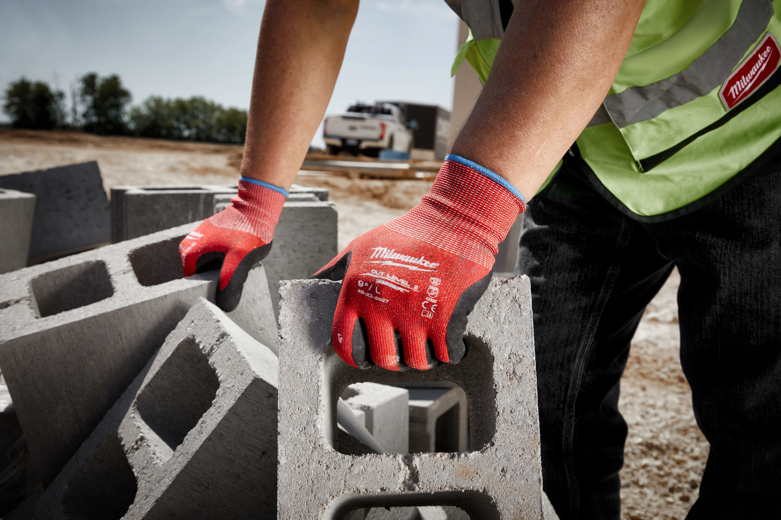
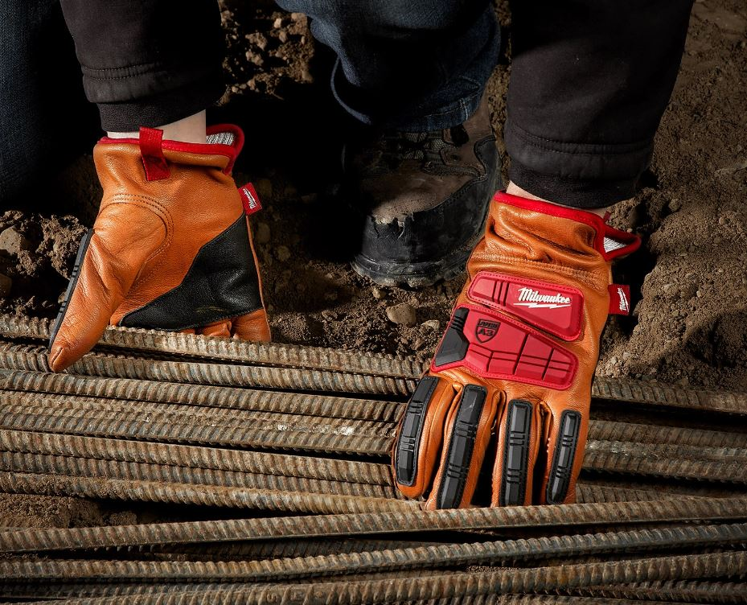
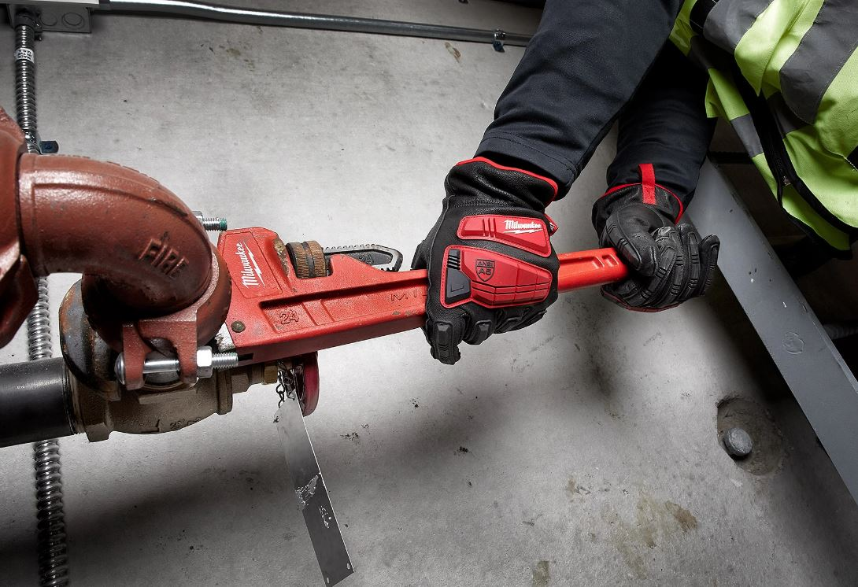

Recap
Topic: Hand Incident Prevention – Material Handling
Abrasion and cut resistant gloves that are breathable help with vigorous material handling..
Cut Level 5 and Impact 2 rated gloves are designed for impact and cut hazards for both the palm and top of the hand protection.
Impact Rated Gloves can protect your hands during knuckle busting hazard type operations.
3

Slide 4

Recap
Project: |  | Supervisor
Date:
Topic: Hand Incident Prevention – Material Handling
Hazards | Precaution
Cut / Laceration hand Injuries. | Boots on the land / gloves on the hand – more often than most, laceration and cuts to the hands and arms occur due to job site conditions during material handling operations. Understanding and recognizing smash hazards associated with the load, or even the rigging, wall vs pipe, materials dislodging during travel, and around heavy equipment is important. Keep hands clear of loads during placement. Watch for snag hazards caused by loose gloves.
Hand / Finger smash hazards | Hand placement while using man-lifts, scissor-lifts, or even ,material hoists is important. Keep hands inside all lifts and off railing during moving or raising to avoid hand smashing hazards. Keep hands out of load landing zones during hoisting operations to avoid load being set on hands and avoid hands between large pipe and pipe fittings during setting operations. They may dislodge and pinch your fingers.
Finger Fracture / cut Hazard | Know injury hazards during material moving operations can exist while working around the below scenarios: 1.Tailgates / tommy lifts on trucks. Watch hands while around them. 2. Job Boxes – watch hands while closing, and secure open if you're going to leave the door open. Hands can get slammed between in the door. Also watch for heavy tools moving while getting into box.
Rigging Operation Hazards | Hand placement during material handling operations is often the reason for severe hand injuries / lacerations and sometimes amputation. Have a plan, talk it through several times before starting the operation. Use pictures to identify hand placement, if possible, to eliminate misunderstandings. Inspecting rigging for broken wires or sharp hazards before use, identify caught between hazards, know the path of movement. Watch for sharp edges.
Crew Member’s Names

